Slide 1
Bogomoletz Institute of Physiology Kiev Ukraine Dr. Pavel Belan
Dissociation of Weak Electrolytes
Дисоціація слабких електролітів
та їх властивости розчинів

Slide 2
План
1. Дисоціація слабих електролітів.
2. Henderson–Hasselbalch Equation.
3. Buffering capacity (Буферна ємність)
4. Іона сила
5. Осмотичність
6. Тонічність

Slide 3
Закон діючих мас
Знову розглянемо хімічну реакцію але будемо вважати, що реакція може йти у обох напрямах:
A + B С
V_{AB} = k₁*[A]*[B], k₁ – константа швидкості прямої реакції.
V_{С} = k₋₁*[С], k₋₁ – константа швидкості зворотньої реакції.
У разі термодинамічної рівноваги:
V_{AB} = V_{С}
k₁*[A]*[B] = k₋₁*[С]
K_{d}=(k₋₁/ k₁)= [A]*[B]/[С]
K_{d} – константа дисоціації

Slide 4
Dissociation of Weak Electrolytes
Weak electrolytes are substances having only a slight tendency to form ions in solution. This makes determining the pH of solutions of weak acids a little more difficult than in the case of strong acids.
The equation will be in the form of a quadratic, which must be solved.
The equation frequently can be simplified by noting that the amount of dissociated species is much less than the amount of undissociated acid.
X = 1.31*10⁻³ M

Slide 5
Simplification of solution

Slide 6
Control task
[x]²≈0.1 x K_{a}
pH = -lg(1.32 x 10⁻³) = 2.88

Slide 7
Control task
What is pH of 9% (W/W or W/V or V/V) acetic acid (CH₃COOH)?
K_{a} for acetic acid is 1.74*10⁻⁵ M.
M_{W} 60 g/mol
Density: 1,05 g/см³

Slide 8
Henderson–Hasselbalch Equation

Slide 9
Buffering capacity of acetic acid
At the same time pH of 0.1N NaOH is 13.0
Thus, acetic acid buffered 0.1N NaOH and changes its pH at 13.0-4.46=8.54; i.e [H+] concentration is higher in the final solution by ~300000000 times compared to solution containing 0.1N NaOH.
How many mL of 0.1N NaOH should be added to 150 mL of 0.2 M acetic acid to have final pH=pKa of acetic acid?

Slide 10
Please calculate the concentration of NaOH, which should be added to
0.01 M HEPES (pK_{a} 7.5) solution to obtain pH 7.5.
HEPES is a monobasic acid:
HEPES = HEPES⁻ + H⁺

Slide 11
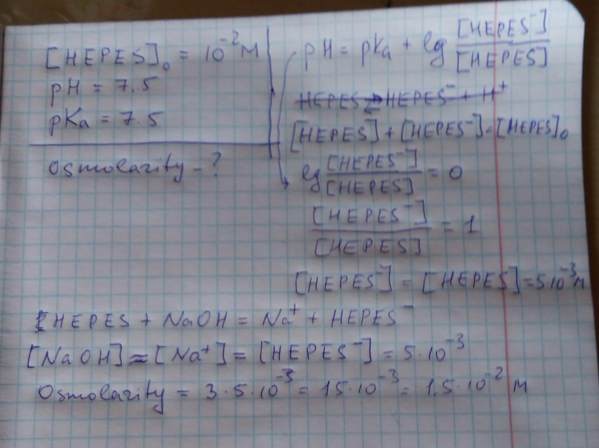

Slide 12
Dissociation Constants of Some Weak Acids
Acid | K_{a}(M) | pK_{a}
Formic acid | 1.78 x 10⁻⁴ | 3.75
Acetic acid | 1.74 x 10⁻⁵ | 4.76
Ammoinium ion | 5.62 x 10⁻¹⁰ | 9.25
Imidazole | 1.02 x 10⁻⁷ | 6.99
Histidine (side chain) | 9.12 x 10⁻⁷ | 6.04
Glycine (carboxylate) | 4.47 x 10-3 | 2.35
Glycine (amino) | 1.66 x 10⁻¹⁰ | 9.78
Carbonic acid 1 | 1.70 x 10⁻⁴ | 6.37
Carbonic acid 2 | 5.75 x 10⁻¹¹ | 10.20
Phosphoic acid 1 | 7.08 x 10⁻³ | 2.14
Phosphoric acid 2 | 6.31 x 10⁻⁸ | 7.20
Phosphoric acid 3 | 3.98 x 10⁻¹³ | 12.40

Slide 13
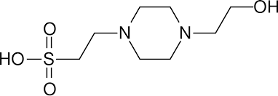
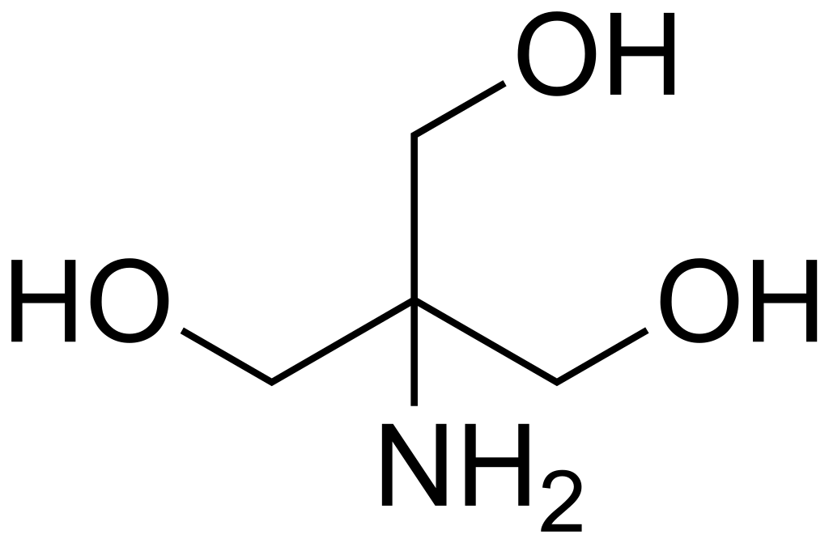
Weak Acids mainly used in our Experiments
HEPES
TRIS
Properties
Chemical formula C₈H₁₈N₂O₄S
Molar mass 238.3012 g/mol
Appearance white crystalline powder
Density Not applicable
Melting point >234-238 °C
Solubility in water 40 g/100 ml (20°C)
Acidity (pKa) 3 (pKa1),
7.5 (pKa2)
Properties
Chemical formula C4H11NO3
Molar mass 121.136 g/mol
Appearance White crystalline powder
Density 1.328g/cm3
Melting point >175-176 °C
Boiling point 219 °C
Solubility in water ~50 g/100 mL (25 °C)
Acidity (pKa) 8.07

Slide 14
What is Ionic strength?
The ionic strength of a solution is a measure of the concentration of ions in that solution.
Ionic compounds, when dissolved in water, dissociate into ions.
The total electrolyte concentration in solution will affect important properties such as the dissociation or the solubility of different salts.
The ionic strength of the solution is the most important parameter in determining such properties of the component ions as their activities and mobilities.
The ionic strength, I, of a solution is a function of the concentration of all ions present in that solution.
What is ionic strength of 9% W/V acetic acid (CH₃COOH)?
Ka for acetic acid is 1.74*10-5 M.
where:
I= ionic strength
c_{i}= concentration of the i^{th} species, mole/L
z_{i}= valence of the i^{th} species
Read more: http://www.lenntech.com/calculators/activity/activitycoefficient.htm#ixzz2yqs9oFke

Slide 15
Calculation example
Please calculate the ionic strength of the following solution:
0.05 M Na₂SO₄, 0.02 M KCl, 0.01 M glucose 0.02 M HEPES (acid)
What is pH of this solution?

Slide 16
Calculation example
I = 1/2 × [(Concentration of Na2SO4 in M × # of Sodium ions × (Charge of Sodium)2) + (Concentration of Na2SO4 in M × # of SO4 ions × (Charge of SO4)2) + (Concentration of KCl × # of Potassium ions × (Charge of Potassium)2) + Concentration of KCl in M × # of Chloride ions × (Charge of Chloride)2)]
I = 1/2 × [(0.050 M × 2 × (+1)2) + (0.050 M × 1 × (−2)2) + (0.020 M × 1 × (+1)2) + 0.020 M × 1 × (−1)2)] = 0.17 M
What is I, which 0.02 M of HEPES add?
HEPES is a monobasic acid:
HEPES = HEPES⁻ + H⁺
Let us denote [H⁺ ] as x. Thus:
K_{a} = x²/(0.02-x)
x ≈ √K_{a} = √10^{-7.5} = √10⁻⁸ * 10^{0.5} =1.78 * 10⁻⁴ M
I_{hepes} = 1/2 * (1.78 * 10⁻⁴ * (-1)² + 1.78 * 10⁻⁴ (1)2 = 1.78 * 10-4 M
I ≈ 0.17 M
pH = -lg(1.78 * 10⁻⁴ ) = 3.75

Slide 17
Osmotic concentration (osmolarity)
φ is the osmotic coefficient, which accounts for the degree of non-ideality of the solution;
n is the number of particles (e.g. ions) into which a molecule dissociates. For example: glucose has n of 1, while NaCl has n of 2;
C is the molar concentration of the solute;
the index i represents the identity of a particular solute.
Notes:
φ is the osmotic coefficient, which accounts for the degree of non-ideality of the solution. In the simplest case it is the degree of dissociation of the solute. Then, φ is between 0 and 1 where 1 indicates 100% dissociation. However, φ can also be larger than 1 (e.g. for sucrose). For salts, electrostatic effects cause φ to be smaller than 1 even if 100% dissociation occurs (see Debye–Hückel equation);
n is the number of particles (e.g. ions) into which a molecule dissociates. For example: glucose has n of 1, while NaCl has n of 2;
C is the molar concentration of the solute;
the index i represents the identity of a particular solute.
Osmolality can be measured using an osmometer which measures colligative properties, such as Freezing-point depression, Vapor pressure, or Boiling-point elevation.

Slide 18
Please calculate the osmolarity of the following solutions:
0.01 M Hepes (pK_{a} 7.5)
pH of this solution was equilibrated with NaOH to 7.5.
HEPES is a monobasic acid:
HEPES = HEPES⁻ + H⁺

Slide 20
Osmolarity versus tonicity
Osmolarity and tonicity are related, but different concepts. Thus, the terms ending in -osmotic (isosmotic, hyperosmotic, hyposmotic) are not synonymous with the terms ending in -tonic (isotonic, hypertonic, hypotonic). The terms are related in that they both compare the solute concentrations of two solutions separated by a membrane. The terms are different because osmolarity takes into account the total concentration of penetrating solutes and non-penetrating solutes, whereas tonicity takes into account the total concentration of only non-penetrating solutes.
Notes:
Osmolarity vs. tonicity
Osmolarity and tonicity are related, but different concepts. Thus, the terms ending in -osmotic (isosmotic, hyperosmotic, hyposmotic) are not synonymous with the terms ending in -tonic (isotonic, hypertonic, hypotonic). The terms are related in that they both compare the solute concentrations of two solutions separated by a membrane. The terms are different because osmolarity takes into account the total concentration of penetrating solutes and non-penetrating solutes, whereas tonicity takes into account the total concentration of only non-penetrating solutes.^{[2]}
Penetrating solutes can diffuse through the cell membrane, causing momentary changes in cell volume as the solutes "pull" water molecules with them. Non-penetrating solutes cannot cross the cell membrane, and therefore osmosis of water must occur for the solutions to reach equilibrium.
A solution can be both hyperosmotic and isotonic.^{[2]} For example, the intracellular fluid and extracellular can be hyperosmotic, but isotonic – if the total concentration of solutes in one compartment is different from that of the other, but ions cannot cross the membrane, it cannot draw water with it, thus causing no net change in solution volume.

Slide 21
Please calculate the osmolarity and tonicity of the following solutions (in relation to neuronal plasma membrane):
0.15 M NaCl, 0.01 M gluose, 0.002 M CaCl₂ and 0.01 M HEPES (pK_{a} 7.5)
pH of this solution was equilibrated with NaOH to 7.5.
HEPES is a monobasic acid:
HEPES = HEPES⁻ + H⁺
It does not cross the plasma membrane.

Slide 22
Home tasks
Please calculate the osmolarity and tonicity of the following solutions (in relation to neuronal plasma membrane):
150 mM NaCl, 20 mM gluose, 2 mM CaCl₂, 1 mM, KCl and 0.01 M Hepes (pK_{a} 7.5)
pH of this solution was equilibrated with NaOH to 7.2.
HEPES is a monobasic acid:
HEPES = HEPES⁻ + H⁺
What is a concentration of Na⁺ in this solution?
What is a concentration of OH⁻ in this solution?

