Slide 1
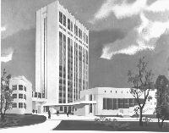
Bogomoletz Institute of Physiology
Kiev
Ukraine
Dr. Pavel Belan
Introduction in Biophysics II
History of Optical Techniques

Slide 2
План
Нерозривний взаємозв'язок фізичних та біологічних явищ.
Розвиток оптики та способів реєстрації експериментальних результатів від мікроскопа Лівенгука до сучасних методів оптичних досліджень.
Мюллерівські клітини сітківки, як приклад оптоволокна розробленого природою.
Квантові точки – сучасні флуоресцентні зонди.

Slide 3
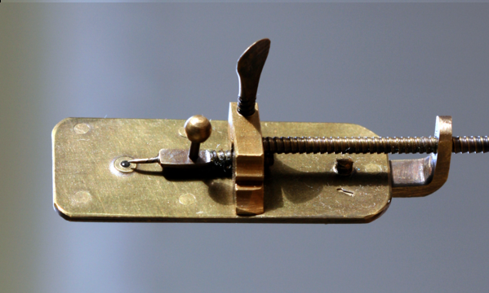
Replica of microscope by Van Leeuwenhoek (17th century)
Notes:
3
Replica of microscope by Van Leeuwenhoek ~1660
Van Leeuwenhoek's interest in microscopes and a familiarity with glass processing led to one of the most significant, and simultaneously well-hidden, technical insights in the history of science. By placing the middle of a small rod of soda lime glass in a hot flame, Van Leeuwenhoek could pull the hot section apart like taffy (ириска) to create two long whiskers of glass. By then reinserting the end of one whisker into the flame, he could create a very small, high-quality glass sphere. These spheres became the lenses of his microscopes, with the smallest spheres providing the highest magnifications. An experienced businessman, Leeuwenhoek realized that if his simple method for creating the critically important lens was revealed, the scientific community of his time would likely disregard or even forget his role in microscopy. He therefore allowed others to believe that he was laboriously spending most of his nights and free time grinding increasingly tiny lenses to use in microscopes, even though this belief conflicted both with his construction of hundreds of microscopes and his habit of building a new microscope whenever he chanced upon an interesting specimen that he wanted to preserve.
Van Leeuwenhoek used samples and measurements to estimate numbers of microorganisms in units of water.[6][7] Van Leeuwenhoek made good use of the huge lead provided by his method. He studied a broad range of microscopic phenomena, and shared the resulting observations freely with groups such as the English Royal Society.[8] Such work firmly established his place in history as one of the first and most important explorers of the microscopic world.

Slide 4
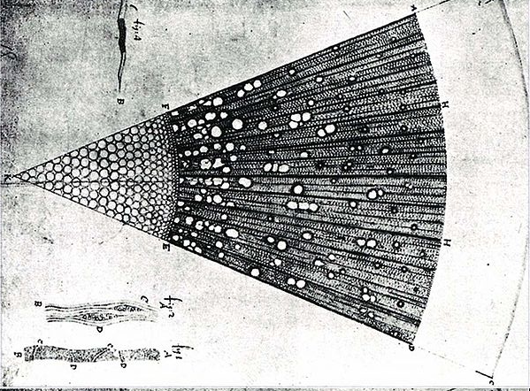
Microscopic section through one year old ash tree
Notes:
4
Microscopic Section through one year old ash tree (Fraxinus) wood, drawing made by Van Leeuwenhoek.

Slide 5
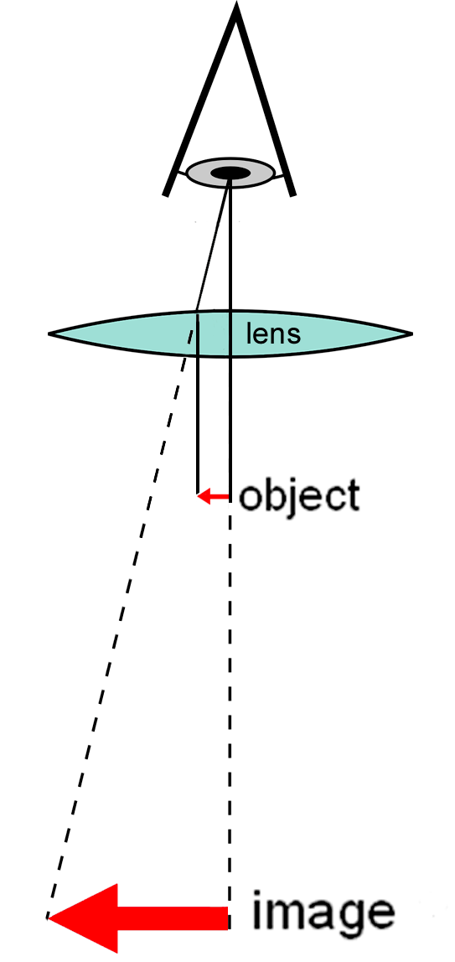
Diagram of a simple microscope
https://en.wikipedia.org/wiki/Optical_microscope

Slide 6
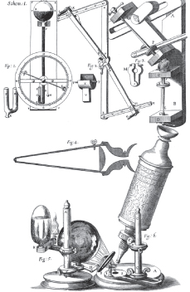
Drawings of the instruments used by Robert Hooke.
Image is reproduced from Micrographia by R. Hooke (1665)
https://www.nature.com/milestones/milelight/full/milelight01.html
Notes:
If a microscope is defined as an instrument that enables the visualization of objects or structures that are usually invisible to the naked eye, then microscopes appeared at the end of the sixteenth century. The properties of concave and convex lenses were first described around the year 1000, although magnifiers in the form of lens-shaped crystals or glass may have been used much earlier. Spectacles were invented around 1300 and became widely used across Europe.
Letters by William Borel, the Dutch envoy to the court of France, mentions the Dutch spectacle-maker Hans Jansen and his son Zacharias as inventors of the first compound microscope in 1595. Their microscope had two lenses combined in a tube in which the magnification was varied by altering the distance between the lenses. However, the Jansens are not known to have published any observations through their microscope; instead, the two names associated with the origin of microscopy are Robert Hooke and Antonie van Leeuwenhoek.
Hooke's masterpiece, known widely as simply Micrographia, was published in 1665 and is the first book on microscopy by a scientist. At the time of Micrographia's publication, Robert Hooke (1638–1703) was a Fellow of the Royal Society in London, holding the position of Curator of Experiments. His refined compound microscope, described and illustrated in the preface to his book, was a forerunner of modern microscopes — equipped with a stage, a light source and three optical lenses. Micrographia puts forward scientific theories on many subjects, as well as containing descriptions of biological and other specimens that are accompanied by beautiful drawings made by Hooke himself. Among these are drawings of a louse and a flea, the compound eye of a fly, seeds and plant sections. He observed the porous structure of cork and famously described the pores as "cells". Although these were not cells in the biological meaning of the word, the modern term derives from Hooke's usage. The book was enormously influential and demonstrated for the first time what microscopy could do for science.

Slide 7
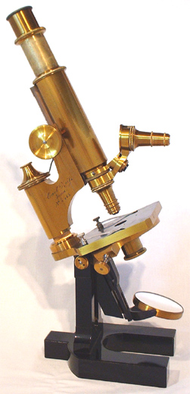
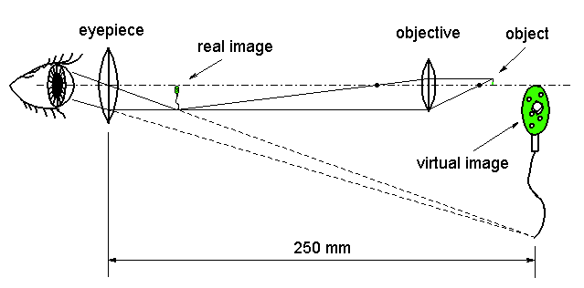
Compound microscope (18th century)

Slide 8
https://slideplayer.com/slide/4465824/ - this slide show Biology 177: Principles of Modern Microscopy Lecture 06: Fluorescence Microscopy can be used for further development of lectures in Fluorescent Microscopy

Slide 9
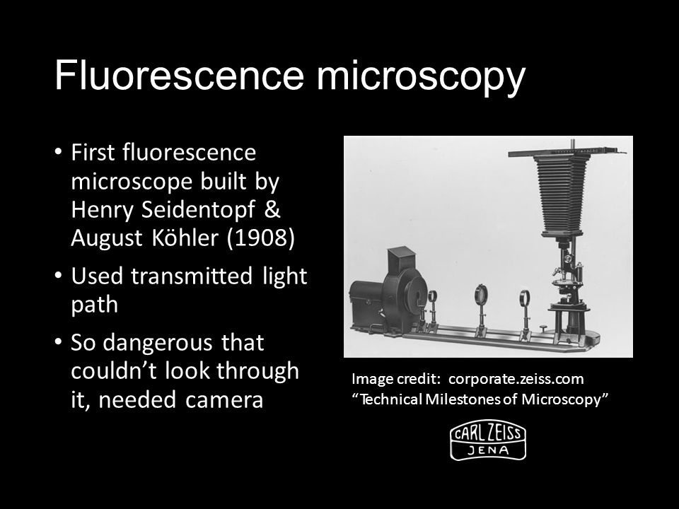
https://slideplayer.com/slide/4465824/
Notes:
First Fluorescence microscope Built by Henry Seidentopf & August Köhler (1908) Used transmitted light path So dangerous that couldn’t look through it, needed camera Image credit: corporate.zeiss.com “Technical Milestones of Microscopy”

Slide 10
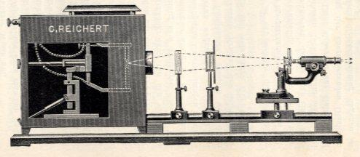
First fluorescent microscope (20th century)
Fluorescence Microscopy, F. W. D. Rost, Cambridge University Press, 1992

Slide 13
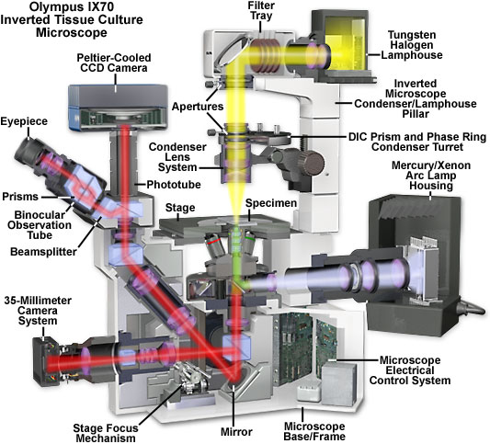
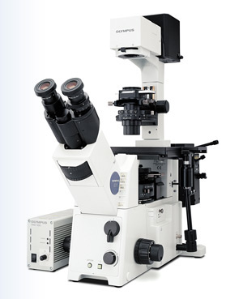
Current optical microscope
Olympus web site

Slide 14
State-of-the-Art microscopes
iMIC Digital Microscopes
Intravital 2P
Copyright © 2006 - 2011 TILL Photonics GmbH

Slide 15
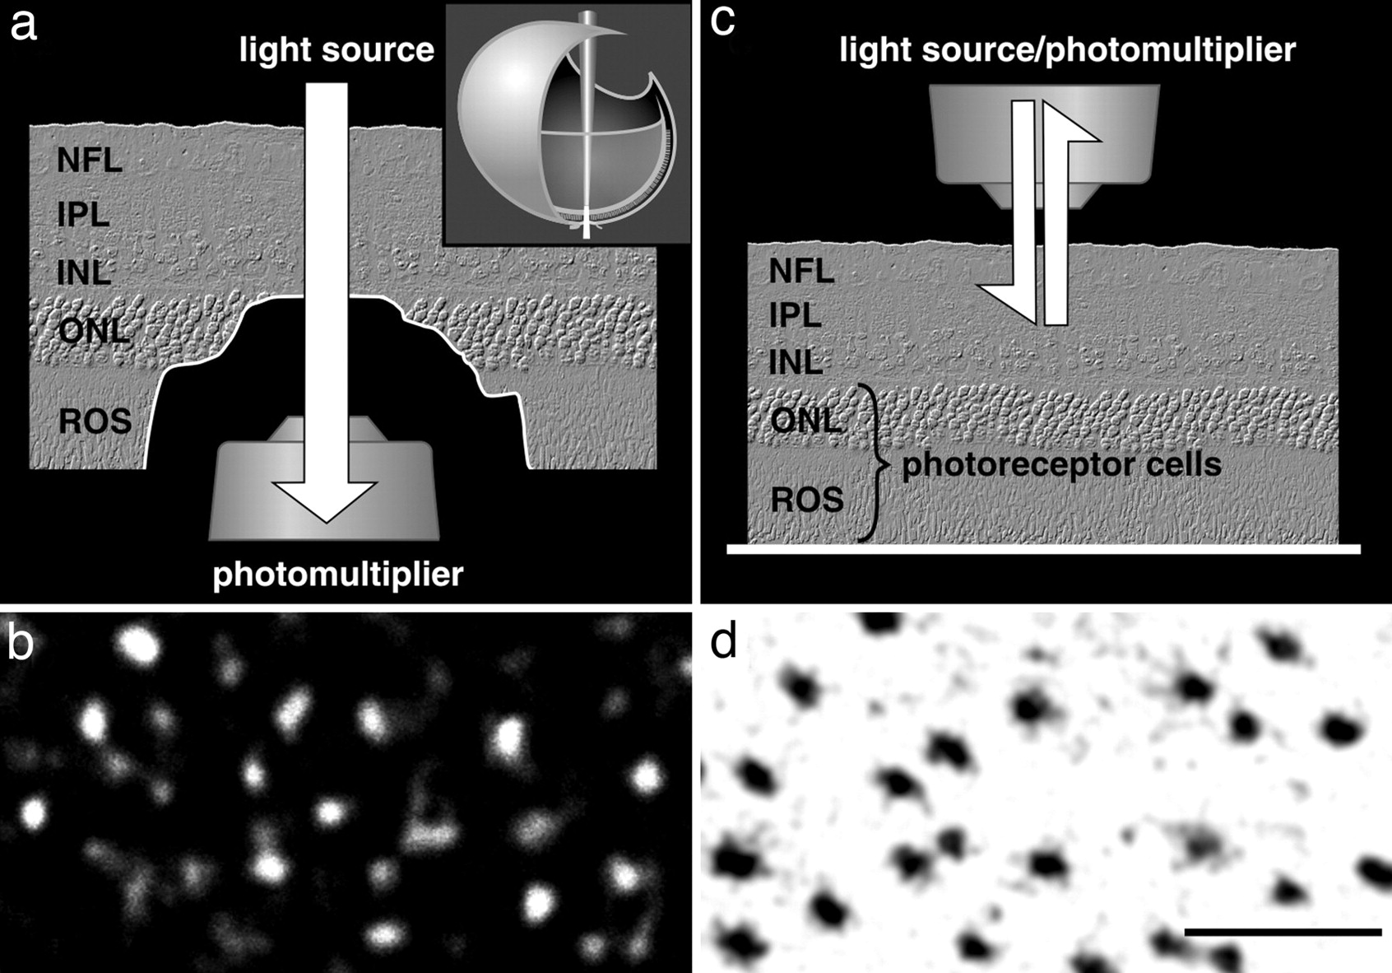
Light transmission and reflection in the inner retina
Inner retina:
NFL, nerve fiber layer;
IPL, inner plexiform layer;
INL, inner nuclear layer
ONL, outer nuclear layer;
ROS, photoreceptor outer segments
Franze K et al. PNAS 2007;104:8287-8292
©2007 by National Academy of Sciences
Notes:
Light transmission and reflection in the inner retina. (a) Experimental design to study light transmission through the inner retina. (Inset) Light emanating from a multimode optical fiber inserted into a freshly dissected eye simulates physiological illumination of the retina. The eye is opened at the posterior side, and all outer structures, including photoreceptor cells, are surgically removed. The laser light (λ = 543 nm) that is transmitted through the inner retina (NFL, nerve fiber layer; IPL, inner plexiform layer; INL, inner nuclear layer) is captured at the end of the prephotoreceptor light path with a confocal microscope. ONL, outer nuclear layer; ROS, photoreceptor outer segments. (b) Confocal transmission image of a living unstained retina. The brighter the signal, the more light is relayed to the corresponding area of the tissue. (c) Light reflection in the inner retina. Laser light is delivered via the microscope objective of an upright confocal microscope, and light scattered back from inner retinal layers is detected. (d) Confocal reflection image at the level of the IPL. The brighter the signal, the more light is reflected by the corresponding area. (Scale bar, 10 μm; also applies to b.)‏
Although biological cells are mostly transparent, they are phase objects that differ in shape and refractive index. Any image that is projected through layers of randomly oriented cells will normally be distorted by refraction, reflection, and scattering. Counterintuitively, the retina of the vertebrate eye is inverted with respect to its optical function and light must pass through several tissue layers before reaching the light-detecting photoreceptor cells. Here we report on the specific optical properties of glial cells present in the retina, which might contribute to optimize this apparently unfavorable situation. We investigated intact retinal tissue and individual Müller cells, which are radial glial cells spanning the entire retinal thickness. Müller cells have an extended funnel shape, a higher refractive index than their surrounding tissue, and are oriented along the direction of light propagation. Transmission and reflection confocal microscopy of retinal tissue in vitro and in vivo showed that these cells provide a low-scattering passage for light from the retinal surface to the photoreceptor cells. Using a modified dual-beam laser trap we could also demonstrate that individual Müller cells act as optical fibers. Furthermore, their parallel array in the retina is reminiscent of fiberoptic plates used for low-distortion image transfer. Thus, Müller cells seem to mediate the image transfer through the vertebrate retina with minimal distortion and low loss. This finding elucidates a fundamental feature of the inverted retina as an optical system and ascribes a new function to glial cells.

Slide 16
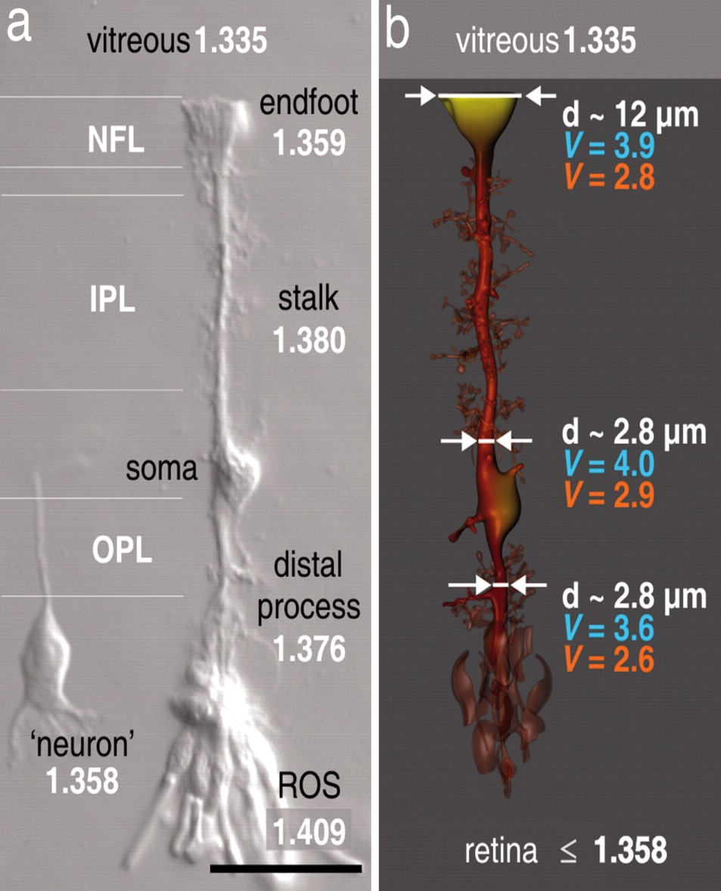
Müller cell shape, refractive properties, and light-guiding capability
Franze K et al. PNAS 2007;104:8287-8292
©2007 by National Academy of Sciences
Notes:
Müller cell shape, refractive properties, and light-guiding capability. (a) Nomarski differential interference contrast microscopy image of a dissociated guinea pig Müller cell with several adherent photoreceptor cells, including their outer segments (ROS) and a dissociated retinal neuron (bipolar cell) to the left. The refractive indices of the different cell sections are given. (b) Schematic illustration of a Müller cell in situ. The lighter the coloring of the Müller cell, the lower the refractive index. Typical diameters and the calculated V parameters for 700 nm (red) and 500 nm (blue) are indicated at the endfoot, the inner process, and the outer process. Although diameters and refractive indices change along the cell, its light-guiding capability remains fairly constant. (Scale bar, 25 μm.)‏

Slide 17
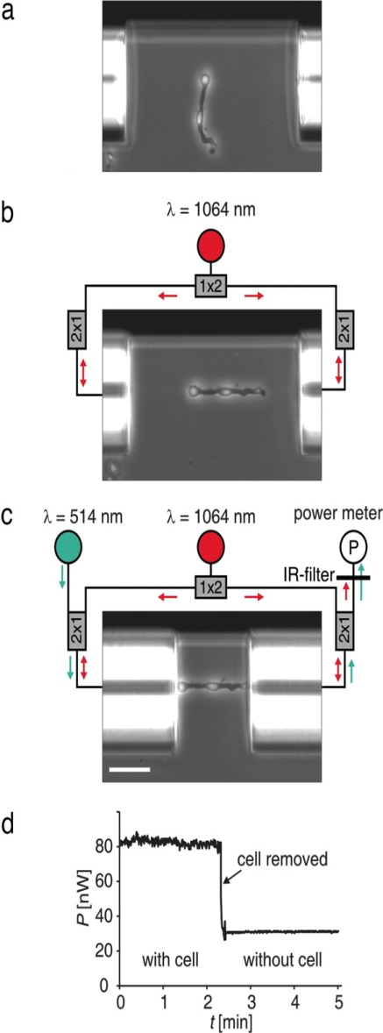
Demonstration of light guidance by individual Müller cells measured in a modified dual-beam laser trap.
Franze K et al. PNAS 2007;104:8287-8292
©2007 by National Academy of Sciences
Notes:
Demonstration of light guidance by individual Müller cells measured in a modified dual-beam laser trap. (a) A cell is floating freely between the ends of two optical fibers, which are aligned against a backstop visible at top. (b) The Müller cell is trapped, aligned, and stretched out by two counterpropagating near-infrared laser beams diverging from the optical fibers (42). (c) The fibers are brought in contact with the cell. Visible light (λ = 514 nm) emerges from the left (input) fiber and is collected and guided by the cell to the right (output) fiber. The fraction of visible light reentering the core of the output fiber is measured by a power meter, and the near-infrared light is blocked by an appropriate short-pass filter. (Scale bar, 50 μm.) (d) Typical time course of the power of visible light measured. When the cell is removed from the trap, it no longer prevents the light from diverging, and the measured power drops considerably. The ratio η = Pwith_cell/Pwithout_cell defines the relative guiding efficiency.

Slide 18
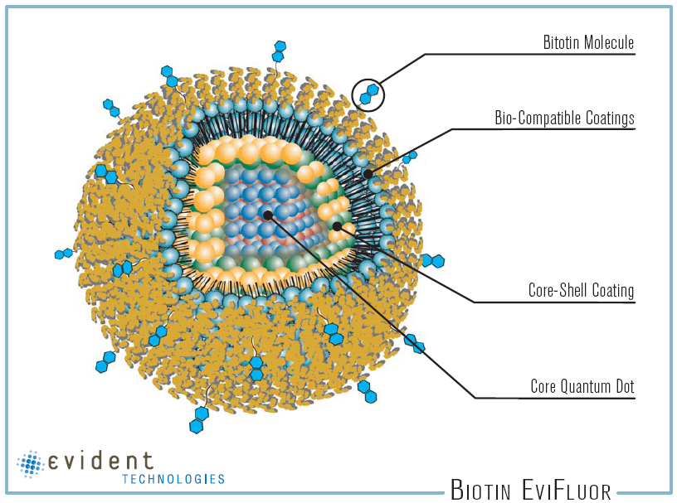
Структура и цвета квантовых точек
Nature Materials, 4:435, 2005
QDot as compared to MBP, a midsize protein
(Mr ~ 44 kDa) with dimensions of 30x40x65 Å
Evident technology web site
Notes:
Quantum Dots structure and colors

Slide 19
(A) Emission maxima and sizes of quantum dots of different composition. Quantum dots can be synthesized from various types of semiconductor materials (II-VI: CdS, CdSe, CdTeI; III-V: InP, InAsI; IV-VI: PbSeI) characterized by different bulk band gap energies. The curves represent experimental data from the literature on the dependence of peak emission wavelength on qdot diameter. The range of emission wavelength is 400 to 1350 nm, with size varying from 2 to 9.5 nm (organic passivation/solubilization layer not included). All spectra are typically around 30 to 50 nm (full width at half maximum). Inset: Representative emission spectra for some materials. (B) Absorption (upper curves) and emission (lower curves) spectra of four CdSe/ZnS qdot samples. The blue vertical line indicates the 488-nm line of an argon-ion laser, which can be used to efficiently excite all four types of qdots simultaneously. (C) Size comparison of qdots and comparable objects. FITC, fluorescein isothiocyanate; GFP, green fluorescent protein; qdot, green (4 nm, top) and red (6.5 nm, bottom) CdSe/ZnS qdot; qrod, rod-shaped qdot; streptavidin (SAV), maltose binding protein (MBP); and immunoglobulin G (IgG).
Quantum Dot Corp.’s Web site.

Slide 20
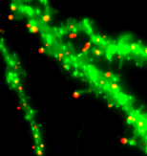
AMPA Receptors Diffuse in and out Spiny Synapses
Neuron web site
Notes:
Movie S2. AMPARs Diffuse in and out Spiny Synapses (AVI 14452 kb)
Movement of GluR1 containing AMPAR-coupled QDots in and out of spiny synapses stained by Homer 1c::TdimerDsRed. Note that several QDs localized on spines are immobile; however, some of them exchanged rapidly between synaptic and extrasynaptic locations. (Real-time speed ×2).

