Slide 1
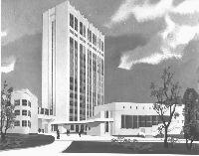
Bogomoletz Institute of Physiology
Kiev
Ukraine
Dr. Pavel Belan
Introduction in Biophysics I
History of Electrophysiology

Slide 2
План
Місце біофізики серед інших природничих дисциплін.
Нерозривний взаємозв'язок фізичних та біологічних явищ.
Відкриття Гальвані та Вольта як основа для розвитку сучасної електрофізіології.
Ідеї та принципи сучасної електрофізіології.
Фізики, які зробили великий внесок у розвиток біології

Slide 3
The scheme of connections among biosciences, fundamental sciences, and some of the applied sciences

Slide 4
Portraits of Luigi Galvani and Lucia Galeazzi
“Commentary on the Force of Electricity on Muscular Motion”
Was published in the seventh volume of the proceedings of the Institute of Sciences at Bologna in 1791
HEKA impulse 04, p. 2-5
Notes:
In the beginning was the Word and this word belonged to Luigi Galvani, who in 1794 conceived the idea of a water-filled channel as a substrate for excitation in animal tissues.
Early life
At first he wished to enter the church. Galvani attended Bologna's medical school and became a doctor, like his father. At the University of Bologna he was, in 1762, appointed public lecturer in anatomy, and gained a reputation as a skilled though not eloquent (красноречивый) teacher, chiefly from his researches on the organs of hearing and genitourinary tract of birds, as a comparative anatomist.
He enunciated his celebrated theory of animal electricity in the treatise, De viribus electricitatis in motu musculari commentarius ("Commentary on the Force of Electricity on Muscular Motion") published in the seventh volume of the proceedings of the Institute of Sciences at Bologna in 1791, and separately at Modena in the following year. In 1764, he married Lucia Galleazzi, a daughter of a professor at the University of Bologna and a popular lady with high social status. In 1772 Galvani became president of the University.
Late 1780s diagram of Galvani's experiment on frog legs
According to popular version of the story, Galvani was slowly skinning a frog at a table where he had been conducting experiments with static electricity by rubbing frog skin. Galvani's assistant touched an exposed sciatic nerve of the frog with a metal scalpel, which picked up a charge. At that moment, they saw sparks and the dead frog's leg kick as if in life. The observation made Galvani the first investigator to appreciate the relationship between electricity and animation — or life. This finding provided the basis for the new understanding that electrical energy (carried by ions), and not air or fluid as in earlier balloonist theories, is the impetus (движущая сила) behind muscle movement. He is poorly credited with the discovery of bioelectricity. Galvani called the term animal electricity to describe the force that activated the muscles of his specimens. Along with contemporaries, he regarded their activation as being generated by an electrical fluid that is carried to the muscles by the nerves. The phenomenon was dubbed galvanism, after Galvani, on the suggestion of his peer and sometime intellectual adversary Alessandro Volta. Today, the study of galvanic effects in biology is called electrophysiology, the term galvanism being used only in historical contexts.
Galvani vs. Volta: animal electricity or heat electricity?
Volta's investigations led shortly to the invention of an early battery, but not by Galvani, who did not perceive electricity as separable from biology. Galvani did not see electricity as the essence of life, which he regarded vitalistically. Galvani believed that the animal electricity came from the muscle. Galvani's associate Alessandro Volta, in opposition, reasoned that the animal electricity was a physical phenomenon caused by rubbing frog skin and not a metallic electricity.
While, as Galvani believed, all frogs contain electrical power, specifically toads. Frog cells and every toad cell has a cell potential, biological electricity has the same chemical underpinnings as the current between electrochemical cells, and thus can be recapitulated in a way outside the body, Volta's intuition was correct. Volta, essentially, objected to Galvani’s conclusions about "animal electric fluid", but the two scientists disagreed respectfully and Volta coined the term "galvanism" for a direct current of electricity produced by chemical action.[3] Thus, owing to an argument between the two in regard to the source or cause of the electricity, Volta built the first battery in order to specifically disprove his associate's theory. Volta's “pile” became known therefore as a voltaic pile.

Slide 5
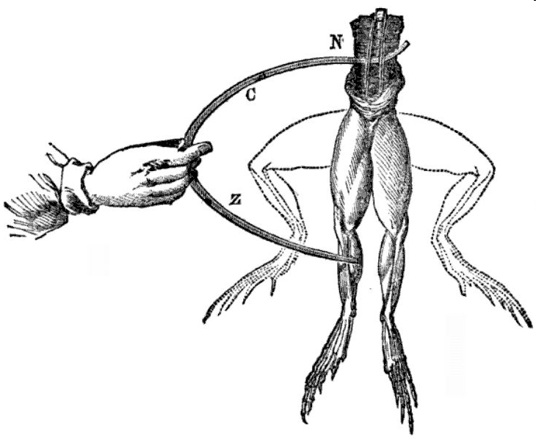
Charged metal touch of frog resulted in the legs twitch
Notes:
Electrodes of Zn and Cu touch a frog, and the legs twitch into the upward position
Late 1780s diagram of Galvani's experiment on frog legs
According to popular version of the story, Galvani was slowly skinning a frog at a table where he had been conducting experiments with static electricity by rubbing frog skin. Galvani's assistant touched an exposed sciatic nerve of the frog with a metal scalpel, which picked up a charge. At that moment, they saw sparks and the dead frog's leg kick as if in life. The observation made Galvani the first investigator to appreciate the relationship between electricity and animation — or life. This finding provided the basis for the new understanding that electrical energy (carried by ions), and not air or fluid as in earlier balloonist theories, is the impetus (движущая сила) behind muscle movement. He is poorly credited with the discovery of bioelectricity. Galvani called the term animal electricity to describe the force that activated the muscles of his specimens. Along with contemporaries, he regarded their activation as being generated by an electrical fluid that is carried to the muscles by the nerves. The phenomenon was dubbed galvanism, after Galvani, on the suggestion of his peer and sometime intellectual adversary Alessandro Volta. Today, the study of galvanic effects in biology is called electrophysiology, the term galvanism being used only in historical contexts.

Slide 6
Wired frog neuro-muscular preparation
Galvani regarded muscles activation as being generated by an electrical fluid that is carried to the muscles by the nerves. The phenomenon was dubbed galvanism, after Galvani. Today, the study of galvanic effects in biology is called electrophysiology.
HEKA impulse 04, p. 2-5
Notes:
Based on years of experimental investigations of neuro-muscular preparations, which
he made together with his wife Lucia Galeazzi (Fig. 1) and his nephew Giovanni Aldini, Galvani postulated that animal electricity results from accumulation of positive and negative charges on external and internal surfaces of the muscle or nerve fibre, which he compared to the internal and external plates of the Leyden jar ((Galvani, 1791, 1794, 1841), see also (Piccolino, 1997)). Excitation required a current flow, which, in turn, was in need of a specific pathway, to which effect Galvani contemplated the existence of water-filled channels, that penetrate the surface of the muscle fibres, and allow the electrical excitability. Once more, comparing the biological tissue to a Leyden jar.

Slide 7
“Channel"-driven mechanism of electrical excitation
Galvani wrote: »let one plaster then this conductor with some insulating substance, as wax... let one make small holes in some part of the plastering that concerns the conductor. Then let one moist with water or with some other conductive fluid all the plastering, having care that the fluid penetrate in the above mentioned holes, and come in contact with the conductor itself«. Certainly, in this case, there is communication through this fluid between the internal and the external surface of the jar ((Galvani, 1794), quoted from (Piccolino, 1997)).
This "channel"-driven mechanism of electrical excitation, became generally accepted more than 150 years after Galvani's death. The insulator surface of the cell, the membrane, turned out to be almost a wax-like structure.
HEKA impulse 04, p. 2-5
Notes:
Galvani wrote: »let one plaster then this conductor with some insulating substance, as wax... let one make small holes in some part of the plastering that concerns the conductor. Then let one moist with water or with some other conductive fluid all the plastering, having care that the fluid penetrate in the above mentioned holes, and come in contact with the conductor itself«. Certainly, in this case, there is communication through this fluid between the internal and the external surface of the jar ((Galvani, 1794), quoted from (Piccolino, 1997)). Scientific excellence has not protected Galvani from political persecution. In 1797, when French revolutionary hordes led by Corsican ogre (страшный человек) occupied Bologna and marionette Cisalpine Republic had been created, the oath of loyalty was demanded from every occupant of public office. Galvani refused and was expelled from the University, which precipitated his untimely demise in 1798.
This "channel"-driven mechanism of electrical excitation,
became generally accepted more than 150 years after
Galvani's death. The insulator surface of the cell, the
membrane, turned out to be almost a wax-like structure.

Slide 8
‘Animal Electricity’ theory introduced by Galvani
Electrodes of Zn and Cu touch a frog, and the legs twitch into the upward position
Notes:
Electrodes of Zn and Cu touch a frog, and the legs twitch into the upward position
Galvani called the term animal electricity to describe the force that activated the muscles of his specimens. Along with contemporaries, he regarded their activation as being generated by an electrical fluid that is carried to the muscles by the nerves. The phenomenon was dubbed galvanism, after Galvani, on the suggestion of his peer and sometime intellectual adversary Alessandro Volta. Today, the study of galvanic effects in biology is called electrophysiology, the term galvanism being used only in historical contexts.

Slide 9
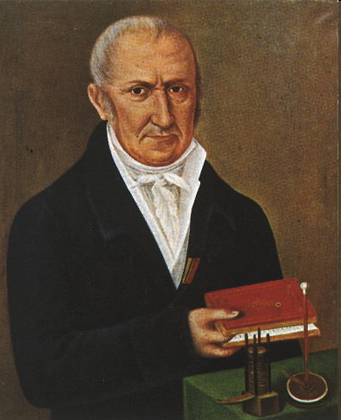
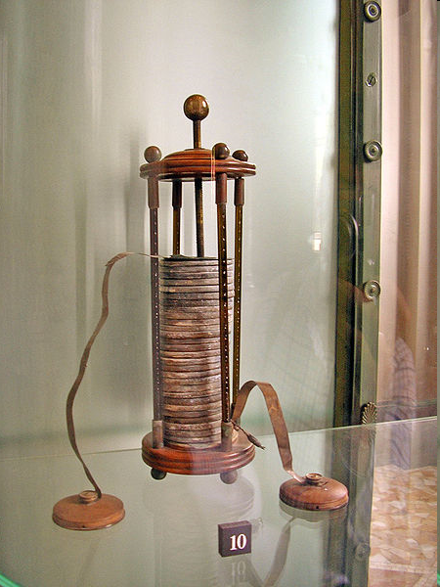
Alessandro Volta
http://en.wikipedia.org/wiki/Alessandro_Volta
Notes:
The "animal electricity" noted by Luigi Galvani when two different metals were connected in series with the frog's leg and to one another. Volta realized that the frog's leg served as both a conductor of electricity (we would now call it an electrolyte) and as a detector of electricity. He replaced the frog's leg with brine-soaked paper, and detected the flow of electricity by other means familiar to him from his previous studies. In this way he discovered the electrochemical series, and the law that the electromotive force (emf) of a galvanic cell, consisting of a pair of metal electrodes separated by electrolyte, is the difference between their two electrode potentials (thus, two identical electrodes and a common electrolyte give zero net emf). This may be called Volta's Law of the electrochemical series.
In 1800, as the result of a professional disagreement over the galvanic response advocated by Galvani, he invented the voltaic pile, an early electric battery, which produced a steady electric current.[5] Volta had determined that the most effective pair of dissimilar metals to produce electricity was zinc and silver. Initially he experimented with individual cells in series, each cell being a wine goblet filled with brine into which the two dissimilar electrodes were dipped. The voltaic pile replaced the goblets with cardboard soaked in brine.

Slide 10
Steps in electrophysiology development
In 1899 the lipoidal membrane hypothesis was made by Charles Overton (Overton, 1899), when he discovered that lipid-soluble dyes enter cells substantially easier than the water-soluble ones.
The bilayer model was proposed by Gorter and Grendel (Gorter and Grendel, 1925).
The bilayer model was perfected by Danielli and Dawson (Danielli and Davson, 1935), who combined the concept of the bilayer lipid membrane with membrane-associated proteins; some of these proteins can penetrate the bilayer and form water-filled pores; the pores allow the passage of lipid-insoluble molecules, including, of course, ions.
Finally, electrophysiological experiments of Hodgkin and Huxley resulted in direct description of transmembrane ion currents and produced a hypothesis of ion channels, able to provide a regulated ("gated") ion passage across plasmalemma (Hodgkin and Huxley, 1952).
Direct monitoring of the currents through ion channels, however, required additional 30 years of exploration.
HEKA impulse 04, p. 2-5
Notes:
In 1899 the lipoidal membrane hypothesis was made
by Charles Overton (Overton, 1899), when he discovered
that lipid-soluble dyes enter cells substantially easier
than the water-soluble ones. Subsequently, the bilayer
model was proposed by Gorter and Grendel (Gorter
and Grendel, 1925), the model, which was perfected by
Danielli and Dawson (Danielli and Davson, 1935), who
combined the concept of the bilayer lipid membrane
with membrane-associated proteins; some of these
proteins can penetrate the bilayer and form water-filled
pores; the pores allow the passage of lipid-insoluble
molecules, including, of course, ions. Finally, electrophysiological
experiments of Hodgkin and Huxley
resulted in direct description of transmembrane ion
currents and produced a hypothesis of ion channels,
able to provide a regulated ("gated") ion passage across
plasmalemma (Hodgkin and Huxley, 1952a, b, c, d).
Direct monitoring of the currents through ion channels
however, required additional 30 years of exploration.

Slide 11
First extracellular fire-polished glass electrodes used for recordings from muscle fibers (Strickholm, 1961, 1962)
HEKA impulse 04, p. 2-5
Notes:
(a) Pipette tip immediately after pulling showing separation at first undulation (неровность поверхности).
Tip too sharp to be used. (b) Heat flashing tip of (a) for a few seconds. Tip adequate for use. (c) Further heat flashing of tip. Tip not satisfactory for use since the leakage resistance path will be too long. For the first time, extracellular glass electrodes were used in 1919 by Frederick Pratt and John Eisenberger (Pratt and Eisenberger, 1919). They manufactured electrodes with tip diameters about 4 - 8 μm and used them for extracellular stimulation of individual skeletal muscle fibres. About four decades later, Alfred Strickholm (Strickholm, 1961, 1962) made the first true extracellular recordings with the aid of extracellular glass electrodes pressed against cell membranes (Fig.2). Using this technique, he was able to measure the impedance of frog muscles, and to record currents, flowing through the small membrane patch under the tip of the extracellular pipette. Several years later, using similar extracellular electrodes Karl Frank and Ladislav Tauc performed voltage-clamp of small patches of the plasmalemma of molluscan neurones, which demonstrated heterogeneous distribution of Na+ channels (Frank and Tauc, 1963).

Slide 12
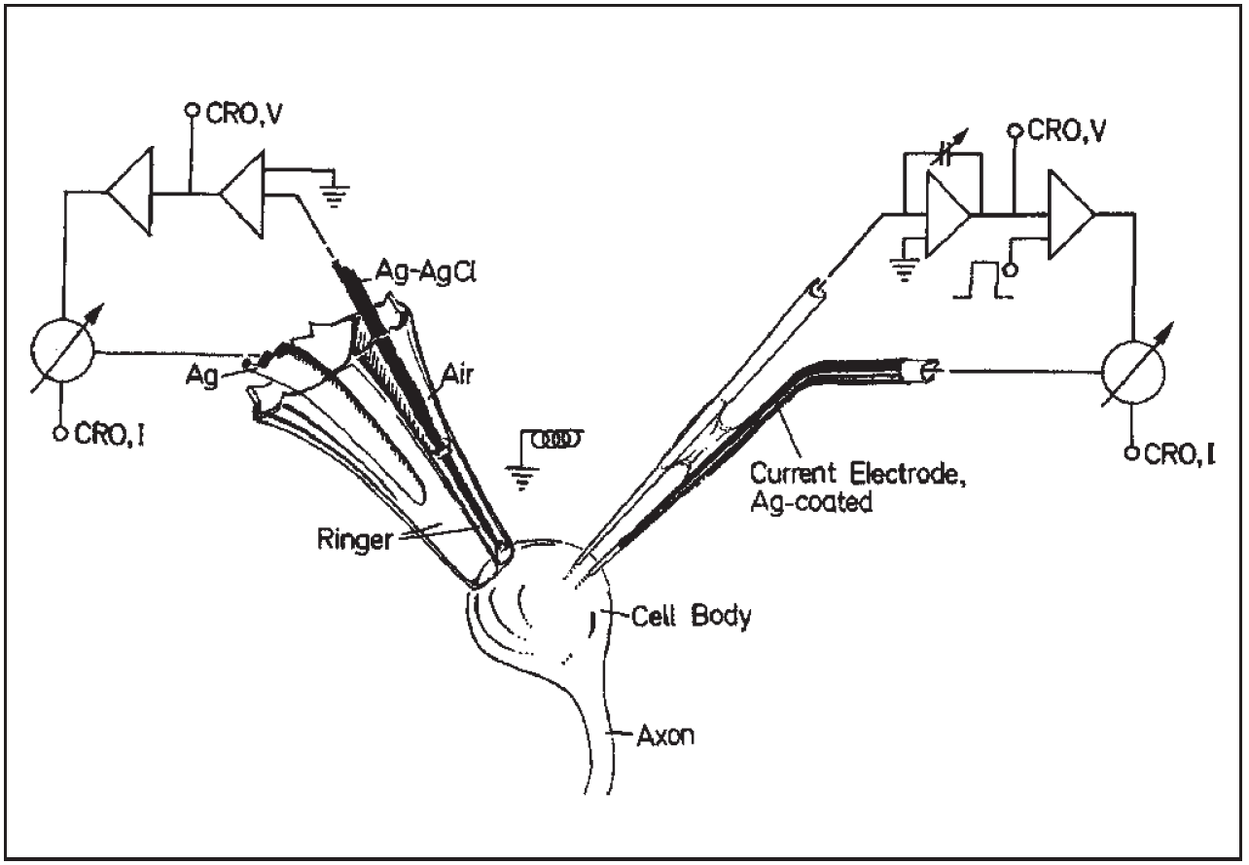
Extracellular voltage-clamp recordings from snail neurones Neher E, Lux HD (1969)
HEKA impulse 04, p. 2-5
Notes:
A. Schematic diagram of the electronic system, and geometry of the pipette.
Current is measured with high input impedance operational amplifiers (Left part of diagram). The
suboesophagael ganglion of Helix pomatia snails was mounted in a lucite
chamber and the connective tissue sheath removed under a dissecting microscope.
The dorsal surface was cleaned as carefully as possible and clusters of cells
exposed. For voltage-clamp the neurone was impaled with an electrode made
from two microelectrodes glued together with a tip separation of 20 - 30 μm.
One of them, the current electrode, was electrolytically coated with silver to
within 50 μm of the tip.
In 1969, a similar technique to monitor membrane currents from the somatic membrane of sub-oesophageal ganglion neurones of Helix pomatia snails (Fig. 3) was developed by Erwin Neher and Hans Dieter Lux (Neher and Lux,1969) (Left part of diagram). They pulled micropipettes from asymmetrical doublebarrelled capillaries to obtain an opening of about 100 - 150 μm in diameter; the tip of the pipette was subsequently fire-polished. Importantly, gentle suction (2 - 10 mm Hg) was applied to the pipette interior, which helped the approach to the neuronal membrane in the ganglia (normally covered by glial cells) and improved the shunt resistance between the pipette wall and the cell membrane.

Slide 13
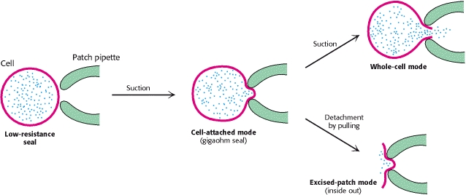
Complete mechanical and electrical isolation of a patch of cell membrane
Notes:
The follow-up of these early attempts helped Neher & Sakmann (Neher and Sakmann, 1976) to develop the first patch-clamp set-up, which resulted in the very first recordings of a single channels. This was a fundamental breakthrough, which was rapidly developed further. In 1980 Fred Sigworth and Erwin Neher (Sigworth and Neher, 1980) obtained the first high resistance (gigaohm) seal between highly cleaned and very smooth micropipette tips and smooth surface cell membranes (the so-called giga-seal). This turned out to be extremely important, since it not only permitted much better electrical recordings, but also allowed entirely new types of electrophysiological experiments (Hamill et al., 1981). The astonishing stability and tightness of the giga-seal interaction between micropipette and cell membrane, allowed not only electrical isolation in situ but also complete mechanical isolation of a patch of cell membrane in either the inside-out or outside-out configurations.

Slide 14
Preparation used for the first recordings of acetylcholine receptor single channel currents from denervated frog
HEKA impulse 04, p. 2-5
Notes:
The Patch-clamp technique (Hamill et al, 1981)
This panel shows the photograph of the preparation used for the first recordings
of acetylcholine receptor single channel currents from denervated frog (Rana
pipiens) cutaneous pectoris muscle (Neher & Sakmann, 1976).

Slide 15
Giga-seal formation between pipette tip and sarcolemma of frog muscle and recordings of single channel currents
HEKA impulse 04, p. 2-5
Notes:
This panel is the reproduction of Fig 6 from 1981 Pflügers Archiv paper (Hamill
et al., 1981), which shows giga-seal formation between pipette tip and
sarcolemma of frog muscle. (A) Schematic diagrams showing a pipette pressed
against the cell membrane when the pipette-membrane seal resistance is of the
order of 50-100 Megohms (left), and after formation of a gigaseal when a small
patch of membrane is drawn into the pipette tip (right). (B) The upper trace
is a continuous current record before, during and after application of suction.
In this experiment a pipette-membrane seal resistance of ~50 M was achieved
by pressing the pipette against the membrane. Single suberyldicholine-induced
channel currents are apparent. During the time indicated by the two arrows
slight suction was applied to the pipette interior, resulting in the formation of
a giga-seal of 60 G resistance. Note reduction in background noise level. The
decrease in channel opening frequency presumably resulted from depletion of
agonist in the pipette tip during suction. It increased again during the minute
following giga-seal formation. The two large current deflections represent
artifacts. The lower traces show single channel currents at higher resolution
before (left) and after (right) formation of a giga-seal. The single channel
current pulse on the right is preceded by capacitive artifacts from a calibration
pulse. All records were made at the cell's resting potential of - 92 mV and at t
t ~ C. They were low pass filtered at 1 kHz (upper trace) or 3 kHz (lower traces)

Slide 16
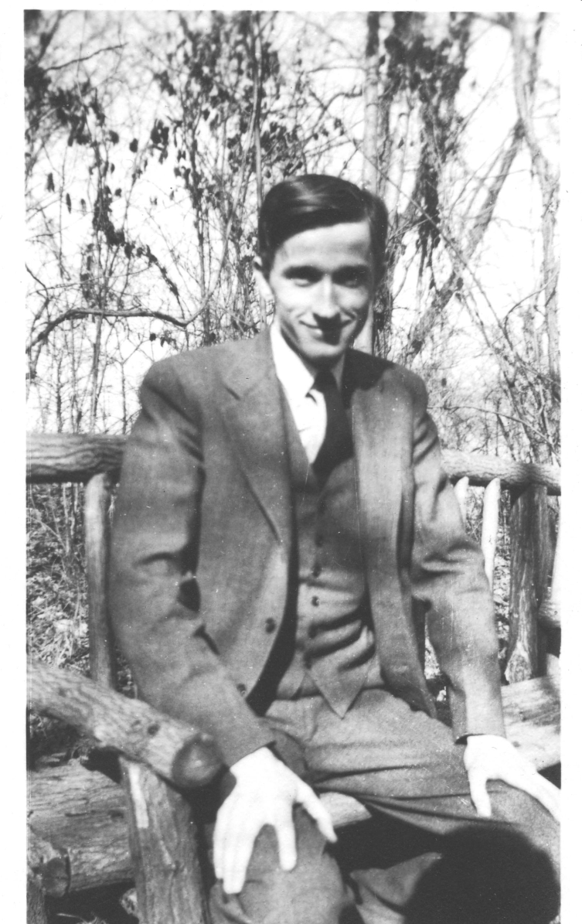
Max Ludwig Henning Delbrück - biophysicist and Nobel laureate
He won the Nobel prize for discovering that bacteria become resistant to viruses as a result of random mutation and not adaptive change
en.wikipedia.org/wiki/Max_Delbrück
Notes:
Delbrück went back to Berlin in 1932 as an assistant to Lise Meitner, who was collaborating with Otto Hahn on the results of irradiating uranium with neutrons. During this period he wrote a few papers, one of which turned out to be an important contribution on the scattering of gamma rays by a Coulomb field due to polarization of the vacuum produced by that field (1933). His conclusion proved to be theoretically sound but inapplicable to the case in point, but 20 years later Hans Bethe confirmed the phenomenon and named it "Delbrück scattering".[1]
In 1942, he and Salvador Luria of Indiana University demonstrated that bacterial resistance to virus infection is caused by random mutation and not adaptive change. This research, known as the Luria-Delbrück experiment, was also significant for its use of mathematics to make quantitative predictions for the results to be expected from alternative models.

Slide 17
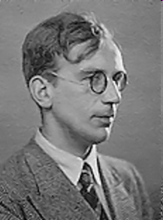
Georgiy Antonovich Gamov a Ukrainian-born theoretical physicist and cosmologist
http://en.wikipedia.org/wiki/George_Gamow#DNA_and_RNA
Notes:
After the discovery of the structure of DNA in 1953 by Francis Crick and James D. Watson, Gamow attempted to solve the problem of how the order of the four different kinds of bases (adenine, cytosine, thymine and guanine) in DNA chains could control the synthesis of proteins from amino acids.[11] Crick has said[12] that Gamow's suggestions helped him in his own thinking about the problem. As related by Crick,[13] Gamow suggested that the twenty combinations of four DNA bases taken three at a time correspond to twenty amino acids used to form proteins. This led Crick and Watson to enumerate the twenty amino acids which are common to most proteins.
However the specific system proposed by Gamow (known as "Gamow's diamonds") was incorrect, as the triplets were supposed to be overlapping (so that in the sequence GGAC (for example), GGA could produce one amino acid and GAC another) and non-degenerate (meaning that each amino acid would correspond to one combination of three bases - in any order). Later protein sequencing work proved that this could not be the case; the true genetic code is non-overlapping and degenerate, and changing the order of a combination of bases does change the amino acid.
After 1954 Gamow was involved in the RNA Tie Club, a discussion group of leading scientists concerned with the problem of the genetic code. One of Gamow's colleagues in the Club was Nobel prize winner James D. Watson, co-discoverer of DNA, who acknowledges Gamow in his own autobiographical writings.[14]

