Slide 1
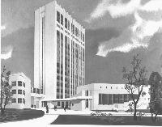
Bogomoletz Institute of Physiology Kiev Ukraine Dr. Pavel Belan
Introduction to Cardiovascular System. Lecture I
Серцево-судинна система. Вступ. Лекція I

Slide 2
План
Навіщо потрібне серце у складі організму?
Навіщо потрібна та як організована судинна система?
Notes:
Как обходятся без сердца одноклеточные?
Есть ли сердце у C. elegans, улитки, мухи?
У каких организмов появляется сердце?

Slide 3
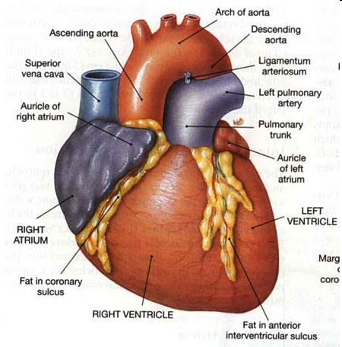
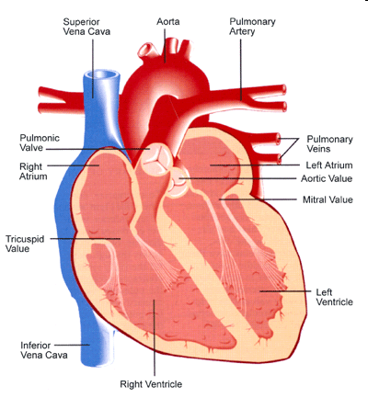
Heart is a Powerful Pump
Notes:
In under a minute, your heart can pump blood to every cell in your body. And over the course of a day, about 100,000 heart beats shuttle 8,000 liters of oxygen-rich blood many times to the cells of our organs and body parts. That's a hefty job for a fist-sized muscle.
Girls rule in some matters of the heart, but when it comes to research into cardiovascular disease it's the guys who come into the spotlight. For decades, heart disease and heart attacks have been viewed as a man's illness. But this is far from the truth. Heart disease kills 500,000 American women each year, topping male numbers by 50,000.
Your body has about 5.6 liters (6 quarts) of blood. This 5.6 liters of blood circulates through the body three times every minute. In one day, the blood travels a total of 19,000 km (12,000 miles)—that's four times the distance across the US from coast to coast.
Here I have to compare the heart with the most advanced pumps developed.
I have to say about development of different devices to study the heart and to exchange it for an artificial one.

Slide 4
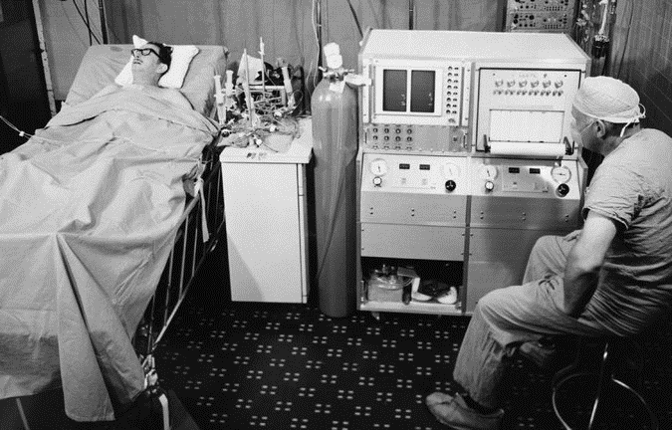
Haskell Karp, the recipient of the first completely artificial heart
Asked in a separate interview whom he considered the greatest surgeon, Dr. Cooley replied, “Besides myself?”
https://kathmanduk2.wordpress.com/2016/11/page/2/
Notes:
Haskell Karp, the recipient of the first completely artificial heart, resting in his recovery room after the surgery, performed by Dr. Denton Cooley, in 1969. A biomedical engineer, John Jurgens, is at right. Mr. Karp lived three days with the device. Credit Bettmann/Corbis
Dr. Denton A. Cooley, the renowned surgeon who was the first to implant a totally artificial heart in a patient and in the process set off one of medicine’s greatest feuds, died on Friday November 18, 2016 at his home in Houston. He was 96.
The Texas Heart Institute, which Dr. Cooley founded, confirmed his death. He stopped performing surgery on his 87th birthday but had never retired, remaining active at the institute as its president emeritus. The institute said he last showed up there on Monday.
A former college basketball star who was a towering presence in the operating room, Dr. Cooley had by age 50 performed more than 5,000 cardiac operations, including 17 heart transplants.
For more than six decades his name was inextricably linked to that of his mentor and former partner, Dr. Michael E. DeBakey, the developer of the artificial heart. Their pioneering techniques for surgery on the heart and blood vessels have helped tens of thousands of patients.
But those advances were overshadowed on April 4, 1969, when Dr. Cooley, working independently of Dr. DeBakey (1908-2008) , performed his groundbreaking implantation without Dr. DeBakey’s authorization. At the time, Dr. DeBakey and a medical team were developing the artificial heart — it was still an experimental device — at Baylor College of Medicine in Houston.
Dr. DeBakey felt betrayed. Suddenly his protégé was his archrival. So began a feud that would last 40 years, reveal much about the personalities and ambitions of the two renowned surgeons and end only a year before Dr. DeBakey’s death in 2008.
Dr. Cooley long defended his action as a doctor’s obligation to do whatever is necessary to save a patient’s life. “If you are a ship out in the ocean and someone throws you a life preserver, you don’t look at it to see if it has been approved by the federal government,” he said in an interview for this obituary.

Slide 5
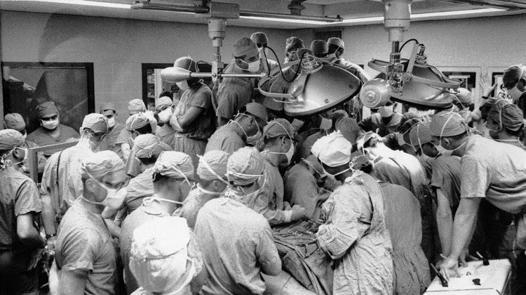
Dr. Denton Cooley performs a coronary artery bypass procedure in 1970. Cooley’s story is one of many told in “Ticker: The Quest to Create an Artificial Heart”

Slide 6
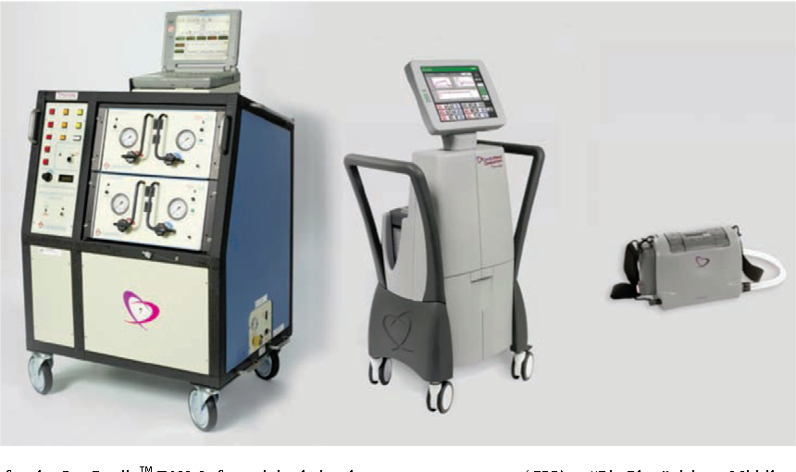
The Freedom Drivers attached to a Total Artificial Heart

Slide 7
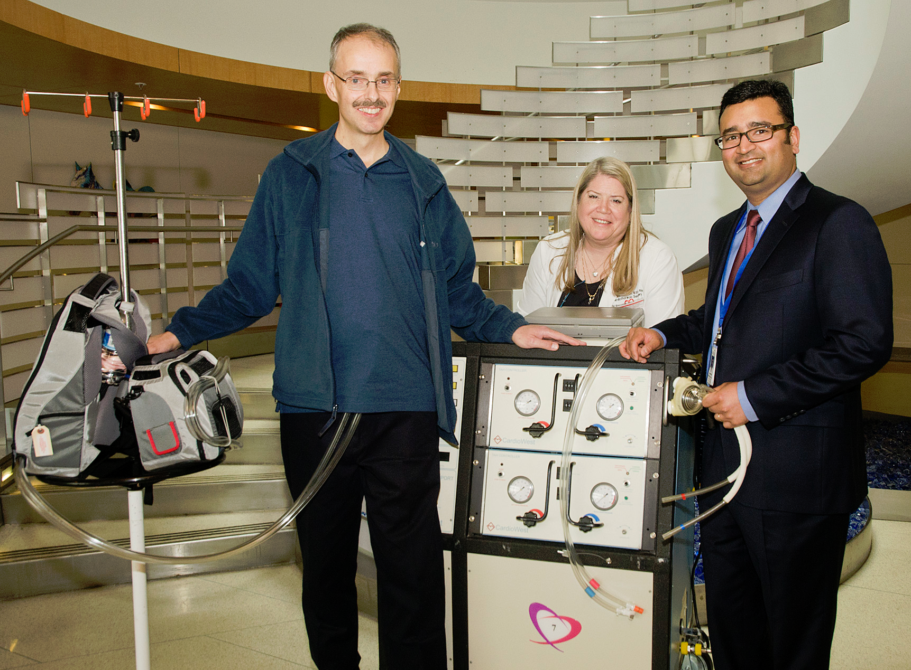
Chris Marshall with his “Freedom Pack” portable device and “Big Blue”
http://www.washington.edu/news/2012/03/21/uw-medical-center-is-first-in-pacific-northwest-to-discharge-a-total-artificial-heart-patient/
Notes:
Year 2012
Chris Marshall with his “Freedom Pack” portable device and “Big Blue,” the machine to which he was connected after the implantation of his artificial heart. With him are his nurse Shauna Andrus and his surgeon Nahush A. MokadamClare McLe
In the implantation procedure, the surgeon removes the patients failing left and right ventricles and all four heart valves. The implanted device consists of two bulbous, polyurethane chambers that act as ventricles. Each chamber has an in-flow and out-flow valve and a four-layer diaphragm. They are sutured into the remaining heart structure: the left and right atria, the aorta and pulmonary artery.
The implanted device has no sensors, motors or electronics. It is powered by a pneumatic driver outside of the patients body, which is connected by two tubes that exit the patients abdominal wall. The driver supplies vacuum pressure to pull the diaphragm to the bottom of the ventricle, allowing blood to enter, then produces a precisely calibrated pulse of air that pushes the diaphragm to the top of the ventricle to fully eject the blood.
During the 10-year clinical study of the Total Artificial Heart that led to its FDA approval in 2004, 79 percent of patients survived until transplant. The Total Artificial Heart has been implanted in more than 1,000 people worldwide, said Michael Garippa, SynCardias CEO. The current longest-supported patient received a transplant after 1,374 days with the device.
During the clinical study, 65 percent of patients who received the SynCardia device were out of bed within five days of surgery, and a similar percentage were walking more than 100 feet within 21 days of implant, the company reports.

Slide 8
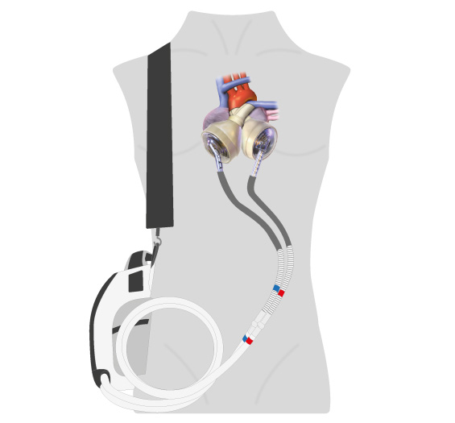
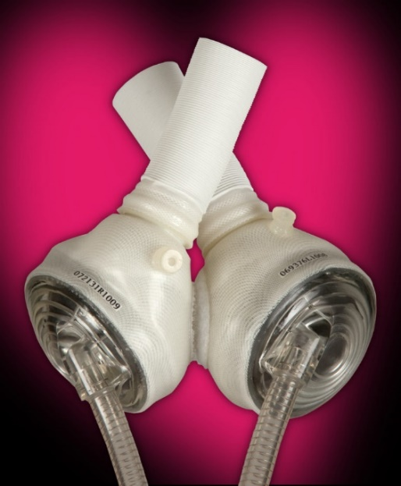
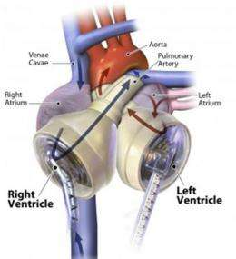
SynCardia TAH, 2019
Just like a human heart, the SynCardia TAH is pulsatile and consists of two ventricles and four valves that pump blood throughout the body. The TAH is made of a special biocompatible plastic, which offers a high degree of fatigue resistance and strength for long-term durability.
https://syncardia.com/patients/home/
Notes:
October 15, 2004: The CardioWest Total Artificial Heart receives FDA approval, becoming the first TAH to do so. The official name given to the device through the FDA approval process is the SynCardia temporary CardioWest™ Total Artificial Heart.

Slide 9
Thoratec heart pump animation
http://www.mylvad.com/lvad-devices/heartmate-II-lvad
Notes:
Heartmate II left ventricular assist system (LVAS) is a small advanced blood pump designed to restore hemodynamic function and improve patient outcomes and quality of life.

Slide 10
Навіщо потрібне серце?
A task: estimation of heart pump volume per day.
Notes:
The heart is necessary for gas exchange, i.e cell respiration. O2 21% in air and less than 10% in tissues; CO2 0.03% in air and 5% in tissues. It is necessary to deliver ‘food’ to cells and take out metabolites. The heart is necessary only for organisms that have certain surface to volume ratio. It is not necessary for very small creatures.
A task: estimation of heart pump volume per day.

Slide 11
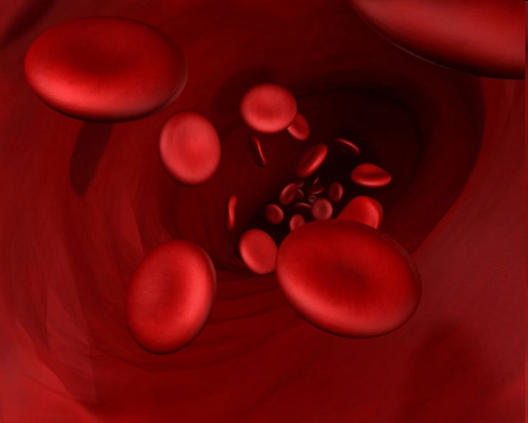
Heart, Blood Vessels, Erythrocytes, Energy Turnover, Metabolism
www.livescience.com
A task: calculation of oxygen consumption based on respiration volume and O₂ concentrations
How to buffer O₂?
Why the arterial blood is pink and venous is dark?
Notes:
about 100,000 km of branching blood vessels that link together the cells of our organs and body parts. Total vessel area about 1500 hektars. I have to ask what the vessels volume is and to indicate that it is amazing that so large area is in so small volume.
Several words about lung here. I have to find lung area. I have to ask what the lung volume is and to indicate that it is amazing that so large area is in so small volume.
A task: calculation of oxygen consumption based on respiration volume and gas concentrations (21% - 10%).
Several words about hemoglobin in the erythrocytes. Why is it necessary? It is an oxygen buffer in the blood. Questions: why the arterial blood is pink and venous is dark? Different conformation of hemoglobin depending on association O2 and Fe. How O2 is transferred via vessels?

Slide 12
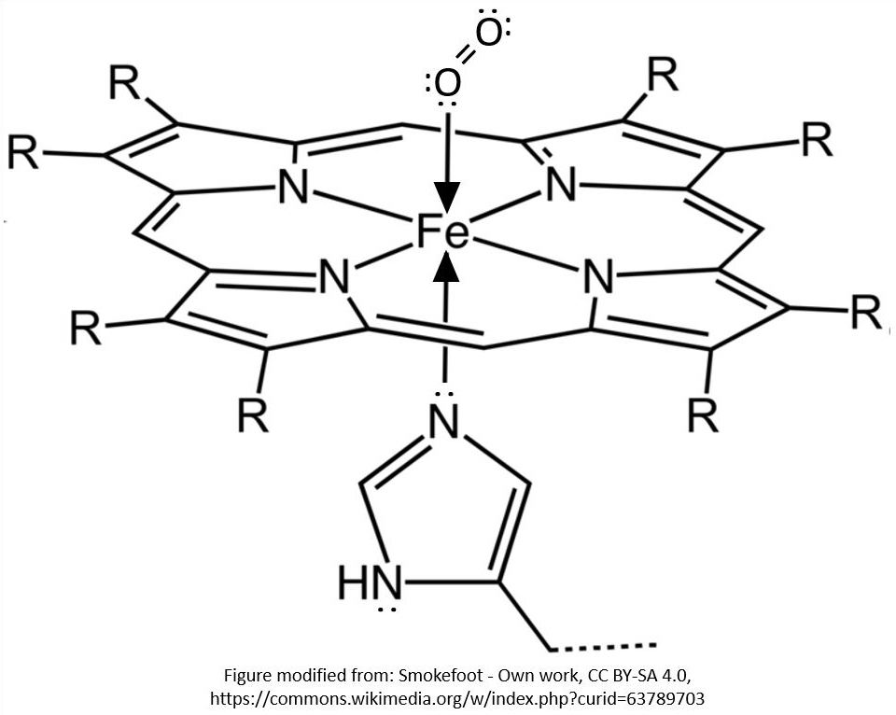
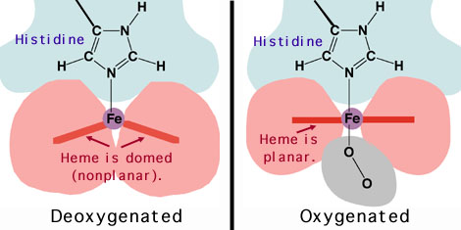
Просторова структура групи гема

Slide 13
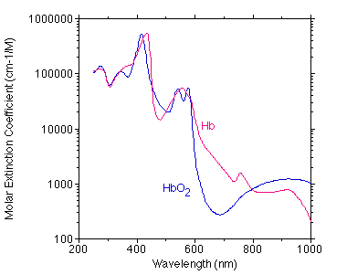
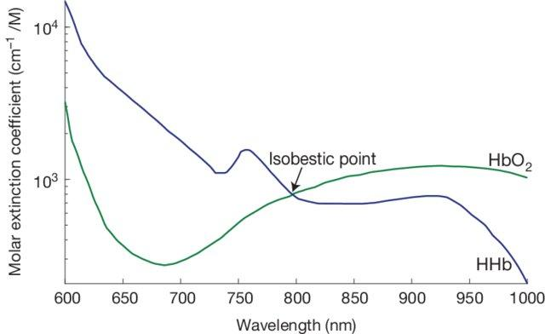
Спектр поглинання фізиологічних форм гемоглобіна
Optical Techniques for Blood and Tissue Oxygenation, DOI: 10.1016/B978-0-12-801238-3.10886-4

Slide 14
Эффект Вериго — Бора (синонимы — эффект Вериго, эффект Бора) — зависимость степени диссоциации оксигемоглобина от величины парциального давления углекислоты в альвеолярном воздухе и крови, при снижении которого сродство кислорода к гемоглобину повышается, что затрудняет переход кислорода из капилляров в ткани. Эффект этот был открыт независимо друг от друга Б. Ф. Вериго в 1892 году^{[1]} и датским физиологом К. Бором в 1904 году^{[2]}.
https://ru.wikipedia.org/wiki/%D0%AD%D1%84%D1%84%D0%B5%D0%BA%D1%82_%D0%92%D0%B5%D1%80%D0%B8%D0%B3%D0%BE_%E2%80%94_%D0%91%D0%BE%D1%80%D0%B0
https://science-medicine.ru/ru/article/view?id=973

Slide 15
Навіщо потрібна та як організована судинна система?
Why the gas consumption/production numbers (5-6% of O2 and about 5% of CO2) related?
Can we estimate our energy consumption having in mind that we spend 200mg of O2 per min?
Measuring gas concentrations in solutions
Notes:
Why the gas numbers (10% of O2 and about 5% of CO2) related? What a chemical reaction in the tissues is mainly supported by respiration? A task: can we estimate our energy consumption just based on gas numbers above? (gluocose +6O2=6H2O + 6CO2).
I have to mention different biophysical devices developed to study respiration and blood flow (e.g monometers). Several words about measuring gas concentrations in solutions.

