Slide 1
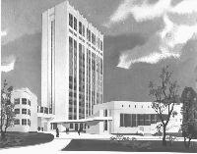
Bogomoletz Institute of Physiology
Kiev
Ukraine
Dr. Pavel Belan
Introduction to Cardiovascular System. Lecture II
Серцево-судинна система. Вступ. Лекція II

Slide 2
План
Сучасні біофізичні методи візуалізації та досліджень судинної системи
Notes:
Как обходятся без сердца одноклеточные?
Есть ли сердце у C. elegans, улитки, мухи?
У каких организмов появляется сердце?

Slide 3
Як можна «побачити» судинну систему?

Slide 4
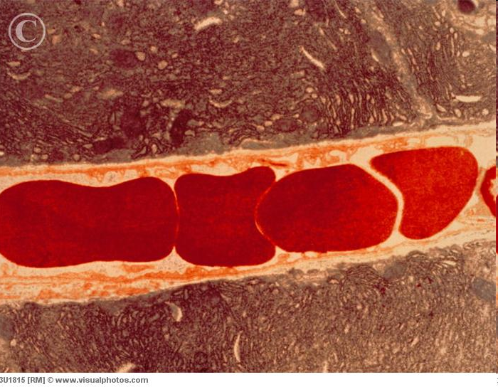
Red blood cells in a capillary vessel
Red blood cells in a capillary vessel. (Color enhanced transmission electron micrograph (TEM) of red blood cells in a capillary vessel. The smallest type of blood vessel, Capillaries contain densely packed Erythrocytes
Notes:
Red blood cells in a capillary vessel. (Color enhanced transmission electron micrograph (TEM) of red blood cells in a capillary vessel. The smallest type of blood vessel, Capillaries contain densely packed Erythrocytes
I have to mention sizes of objects here.

Slide 5
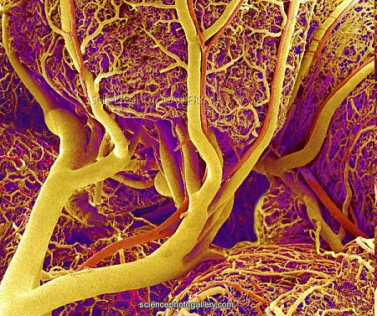
Small intestine blood vessel image obtained by SEM Scanning Electron Microscopy
Notes:
Small intestine blood vessels. Coloured scanning electron micrograph (SEM) of a resin cast of blood vessels in the duodenum region of the small intestine. The thick blood vessels (orange) are the veins, while the thinner blood vessels (red) are the arteries. These bring blood to and from the smallest blood vessels (capillaries) that infiltrate the walls of the intestine, forming the structure seen here. It is in the capillaries that nutrients (from digested food) and gases(oxygen for energy and waste carbon dioxide) are exchanged with the intestinal tissues. The cast was made by injecting resin into the bloodvessels. The surrounding tissues were then chemically digested.
I have to mention the procedure to get this image and SEM as an equipment that is used.

Slide 6
Яким чином можна «побачити» судинну систему, що нормально функціонує, і заміряти швидкість кровотоку?
Як зробити це для людини та експериментальних тварин?
Notes:
Briefly describe different approaches indicated below. But first ask how students suggest to see and measure the blood vessels and blood flow.
Taken from www.bme.ogi.edu/biomedicaloptics/biophotonics/projects.html#OMAG
Numerous techniques have been applied to image the cerebral blood flow (CBF) and
volume changes. Conventional X-ray carotid (сонная артерия) angiography is an excellent clinical tool;
however, it is invasive and not suitable for small animal studies. Although autoradiographic
methods provide endpoint 3D spatial information, they contain no information about the
dynamic CBF evolution [6]. Methods based on magnetic resonance imaging [7] and positron
emission tomography [8] provide spatial maps of CBF but are limited in their temporal and
spatial resolution. Optical intrinsic signal imaging [9], laser speckle imaging [10] and laser-
Doppler flowmetry techniques [11] have the desired high spatial resolution, but are limited to
two-dimensional mapping of CBF and require surgical opening or substantial thinning of the
cranium during the study. Photoacoustic imaging, based on thermal-acoustic phenomena
resulting from the strong light absorption of blood and the subsequent thermo-elastic
expansion, has recently been reported to map vascular structures deep within the brain of
small animals [12,13]. However, the spatial (~100 μm) resolution of this approach is limited
by the viscoelastic filtering of higher acoustic frequencies by the tissue. Moreover, blood flow
information is not forthcoming with this method. Confocal microscopy, a widely used
technique that is capable of ultrahigh resolution mapping of the cerebrovasculature [14], also
requires the removal of intervening bone due to its limited imaging depth (up to 300 μm) and
the use of injected fluorescent tissue markers.

Slide 7
Numerous techniques have been applied to image the cerebral blood flow (CBF) and volume changes
Conventional X-ray angiography (e.g. carotid) is an excellent clinical tool; however, it is invasive and not suitable for small animal studies; in general, autoradiographic methods provide endpoint 3D spatial information, although they contain no information about the dynamic CBF evolution.
Methods based on magnetic resonance imaging and positron emission tomography provide spatial maps of CBF but are limited in their temporal and spatial resolution.
Laser-Doppler flowmetry technique has the desired high spatial resolution, but are limited to two-dimensional mapping of CBF and require surgical opening or substantial thinning of thecranium during the study.
Confocal microscopy, a widely used technique that is capable of ultrahigh resolution mapping of the cerebrovasculature, also requires the removal of intervening bone due to its limited imaging depth (up to 300 μm) and the use of injected fluorescent tissue markers.
Notes:
Numerous techniques have been applied to image the cerebral blood flow (CBF) and
volume changes. Conventional X-ray carotid (сонная артерия) angiography is an excellent clinical tool;
however, it is invasive and not suitable for small animal studies. Although autoradiographic
methods provide endpoint 3D spatial information, they contain no information about the
dynamic CBF evolution [6]. Methods based on magnetic resonance imaging [7] and positron
emission tomography [8] provide spatial maps of CBF but are limited in their temporal and
spatial resolution. Optical intrinsic signal imaging [9], laser speckle imaging [10] and laser-
Doppler flowmetry techniques [11] have the desired high spatial resolution, but are limited to
two-dimensional mapping of CBF and require surgical opening or substantial thinning of the
cranium during the study. Photoacoustic imaging, based on thermal-acoustic phenomena
resulting from the strong light absorption of blood and the subsequent thermo-elastic
expansion, has recently been reported to map vascular structures deep within the brain of
small animals [12,13]. However, the spatial (~100 μm) resolution of this approach is limited
by the viscoelastic filtering of higher acoustic frequencies by the tissue. Moreover, blood flow
information is not forthcoming with this method. Confocal microscopy, a widely used
technique that is capable of ultrahigh resolution mapping of the cerebrovasculature [14], also
requires the removal of intervening bone due to its limited imaging depth (up to 300 μm) and
the use of injected fluorescent tissue markers.

Slide 8
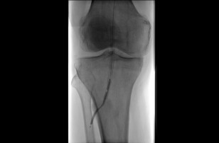
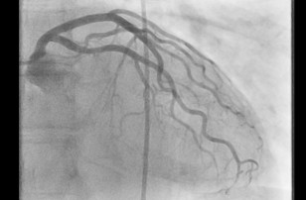
X-ray angiography
Angiogram of a blood vessel in the region of the knee.
Cardiac imaging acquisition using a special low dose program
Radiocontrast agents are substances used to enhance the visibility of internal structures in X-ray-based imaging techniques. Radiocontrast agents are typically iodine, or more rarely barium-sulphate. They absorb external X-rays, resulting in decreased exposure on the X-ray detector.
Notes:
Angiography
Angiography is an X-ray technique used in the examination of the arteries, veins and organs to diagnose and treat blockages and other blood vessel problems. An interventional radiologist performs the procedure, known as an angiogram. During the angiogram, the radiologist inserts a thin tube, called a catheter, into an artery or vein from an access point. This can be in the groin or the arm (пахової частини руки); the precise location depends on the area of the body being examined. A substance called a contrast agent is injected to make the blood vessels visible on the X-ray image, e.g. vessels around the knee (Figure 1) ¹, vessels around the heart (Figure 2) ². The agent is later eliminated from the body through the kidneys and urine.
Fig. 1: Angiogram of a blood vessel in the region of the knee.
One of the most common uses of angiograms is to identify blockages in, or narrowing of, blood vessels that could interfere with the normal blood flow in many parts of the body, including the brain, heart, abdomen, and legs. In many cases, the interventional radiologist can treat a blocked blood vessel while the angiogram is performed without the need for surgery.
Fig. 2: Cardiac imaging acquisition using a special low dose program.
Your doctor may recommend an angiogram to diagnose a variety of vascular conditions, including:
Blockages of the arteries outside the heart (peripheral arterydisease, PAD)
Enlargement of the arteries (aneurysms)
Problems with the veins (deep vein thrombosis, DVT) or blood clots in the lungs (pulmonary emboli)
Problems in the arteries that branch off the aorta (aortic arch conditions)
Malformed arteries (vascular malformations)
Kidney artery conditions (renovascular conditions)
Angiography is performed with various technologies, for example X-ray using fixed C-arm systems (Figure 3), computed tomography (CT) and magnetic resonance imaging (MRI).
Fig. 3: Fixed C-arm system.
Doctors and manufacturers do all they can to minimize radiation dose, and further reduce the risks involved. Nevertheless, women should always inform their physician or X-ray technologist if there is any possibility that they are pregnant.

Slide 9
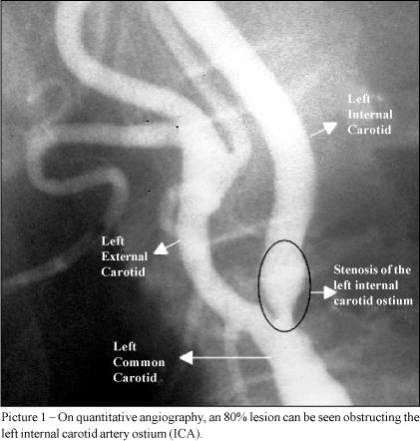
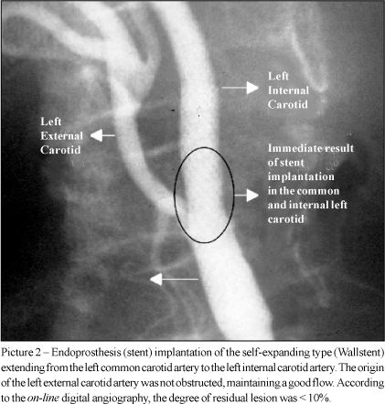
X-ray angiography
http://www.scielo.br/scielo.php?script=sci_arttext&pid=S0066-782X2003000100007

Slide 10
Numerous techniques have been applied to image the cerebral blood flow (CBF) and volume changes
Conventional X-ray angiography (e.g. carotid – сонная артерия) is an excellent clinical tool; however, it is invasive and not suitable for small animal studies; in general, autoradiographic methods provide endpoint 3D spatial information, they contain no information about the dynamic CBF evolution.
Methods based on magnetic resonance imaging and positron emission tomography provide spatial maps of CBF but are limited in their temporal and spatial resolution.
Laser-Doppler flowmetry technique has the desired high spatial resolution, but are limited to two-dimensional mapping of CBF and require surgical opening or substantial thinning of thecranium during the study.
Confocal microscopy, a widely used technique that is capable of ultrahigh resolution mapping of the cerebrovasculature, also requires the removal of intervening bone due to its limited imaging depth (up to 300 μm) and the use of injected fluorescent tissue markers.
Notes:
Numerous techniques have been applied to image the cerebral blood flow (CBF) and
volume changes. Conventional X-ray carotid angiography is an excellent clinical tool;
however, it is invasive and not suitable for small animal studies. Although autoradiographic
methods provide endpoint 3D spatial information, they contain no information about the
dynamic CBF evolution [6]. Methods based on magnetic resonance imaging [7] and positron
emission tomography [8] provide spatial maps of CBF but are limited in their temporal and
spatial resolution. Optical intrinsic signal imaging [9], laser speckle imaging [10] and laser-
Doppler flowmetry techniques [11] have the desired high spatial resolution, but are limited to
two-dimensional mapping of CBF and require surgical opening or substantial thinning of the
cranium during the study. Photoacoustic imaging, based on thermal-acoustic phenomena
resulting from the strong light absorption of blood and the subsequent thermo-elastic
expansion, has recently been reported to map vascular structures deep within the brain of
small animals [12,13]. However, the spatial (~100 μm) resolution of this approach is limited
by the viscoelastic filtering of higher acoustic frequencies by the tissue. Moreover, blood flow
information is not forthcoming with this method. Confocal microscopy, a widely used
technique that is capable of ultrahigh resolution mapping of the cerebrovasculature [14], also
requires the removal of intervening bone due to its limited imaging depth (up to 300 μm) and
the use of injected fluorescent tissue markers.

Slide 11
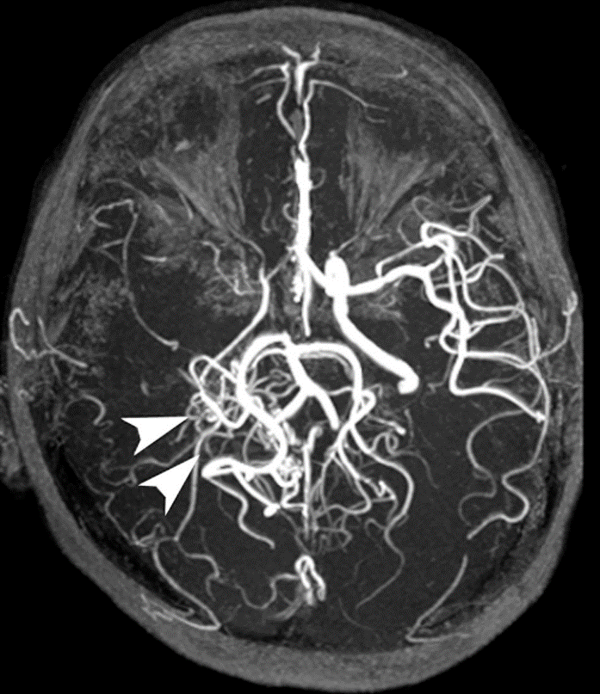
Dynamic contrast-enhanced perfusion magnetic resonance imaging
Magnetic resonance angiography–also called a magnetic resonance angiogram or MRA–is a type of MRI that looks specifically at the body’s blood vessels. Unlike a traditional angiogram, which requires inserting a catheter into the body, magnetic resonance angiography is a far less invasive and less painful test.
https://jamanetwork.com/journals/jamaneurology/article-abstract/787889
Notes:
The most frequently applied MRA methods involve the use intravenous contrast agents, particularly those containing gadolinium to shorten the T₁ of blood to about 250 ms, shorter than the T₁ of all other tissues (except fat). Short-TR sequences produce bright images of the blood. However, many other techniques for performing MRA exist, and can be classified into two general groups: 'flow-dependent' methods and 'flow-independent' methods.
In nuclear magnetic resonance, Spin–lattice relaxation is the mechanism by which the component of the total nuclear magnetic moment vector which is parallel to the constant magnetic field relaxes from a higher energy, non-equilibrium state to thermodynamic equilibrium with its surroundings (the "lattice"). It is characterized by the spin–lattice relaxation time, a time constant known as T₁.
There is a different parameter, T₂, the spin-spin relaxation time, which concerns the relaxation of components of the nuclear magnetization vector which are perpendicular to the external magnetic field. Measuring the variation of T₁ and T₂ in different materials is the basis for some magnetic resonance imaging techniques.
https://en.wikipedia.org/wiki/Magnetic_resonance_angiography
Flow-dependent angiography
One group of methods for MRA is based on blood flow. Those methods are referred to as flow dependent MRA. They take advantage of the fact that the blood within vessels is flowing to distinguish the vessels from other static tissue. That way, images of the vasculature can be produced. Flow dependent MRA can be divided into different categories: There is phase-contrast MRA (PC-MRA) which utilizes phase differences to distinguish blood from static tissue and time-of-flight MRA (TOF MRA) which exploits that moving spins of the blood experience fewer excitation pulses than static tissue, e.g. when imaging a thin slice.
Time-of-flight (TOF) or inflow angiography, uses a short echo time and flow compensation to make flowing blood much brighter than stationary tissue. As flowing blood enters the area being imaged it has seen a limited number of excitation pulses so it is not saturated, this gives it a much higher signal than the saturated stationary tissue. As this method is dependent on flowing blood, areas with slow flow (such as large aneurysms) or flow that is in plane of the image may not be well visualized. This is most commonly used in the head and neck and gives detailed high-resolution images. It is also the most common technique used for routine angiographic evaluation of the intracranial circulation in patients with ischemic stroke.^{[1]}
Flow-independent angiography
Whereas most of techniques in MRA rely on contrast agents or flow into blood to generate contrast (Contrast Enhanced techniques), there are also non-contrast enhanced flow-independent methods. These methods, as the name suggests, do not rely on flow, but are instead based on the differences of T₁, T₂ and chemical shift of the different tissues of the voxel. One of the main advantages of this kind of techniques is that we may image the regions of slow flow often found in patients with vascular diseases more easily. Moreover, non-contrast enhanced methods do not require the administration of additional contrast agent, which have been recently linked to nephrogenic systemic fibrosis in patients with chronic kidney disease and renal failure.

Slide 12
Numerous techniques have been applied to image the cerebral blood flow (CBF) and volume changes
Conventional X-ray angiography (e.g. carotid – сонная артерия) is an excellent clinical tool; however, it is invasive and not suitable for small animal studies; in general, autoradiographic methods provide endpoint 3D spatial information, they contain no information about the dynamic CBF evolution.
Methods based on magnetic resonance imaging and positron emission tomography provide spatial maps of CBF but are limited in their temporal and spatial resolution.
Laser-Doppler flowmetry technique has the desired high spatial resolution, but are limited to two-dimensional mapping of CBF and require surgical opening or substantial thinning of the cranium during the study.
Confocal microscopy, a widely used technique that is capable of ultrahigh resolution mapping of the cerebrovasculature, also requires the removal of intervening bone due to its limited imaging depth (up to 300 μm) and the use of injected fluorescent tissue markers.
Notes:
Numerous techniques have been applied to image the cerebral blood flow (CBF) and
volume changes. Conventional X-ray carotid angiography is an excellent clinical tool;
however, it is invasive and not suitable for small animal studies. Although autoradiographic
methods provide endpoint 3D spatial information, they contain no information about the
dynamic CBF evolution [6]. Methods based on magnetic resonance imaging [7] and positron
emission tomography [8] provide spatial maps of CBF but are limited in their temporal and
spatial resolution. Optical intrinsic signal imaging [9], laser speckle imaging [10] and laser-
Doppler flowmetry techniques [11] have the desired high spatial resolution, but are limited to
two-dimensional mapping of CBF and require surgical opening or substantial thinning of the
cranium during the study. Photoacoustic imaging, based on thermal-acoustic phenomena
resulting from the strong light absorption of blood and the subsequent thermo-elastic
expansion, has recently been reported to map vascular structures deep within the brain of
small animals [12,13]. However, the spatial (~100 μm) resolution of this approach is limited
by the viscoelastic filtering of higher acoustic frequencies by the tissue. Moreover, blood flow
information is not forthcoming with this method. Confocal microscopy, a widely used
technique that is capable of ultrahigh resolution mapping of the cerebrovasculature [14], also
requires the removal of intervening bone due to its limited imaging depth (up to 300 μm) and
the use of injected fluorescent tissue markers.

Slide 13
If a wave with frequency ω is scattered from a moving particle with velocity v; the Doppler shift can be written as
where kI is the incident wave vector, ks is the wave vector of the scattered wave, and β is the angle between the velocity vector and the scattering vector, which is defined as (kI - ks)

Slide 14
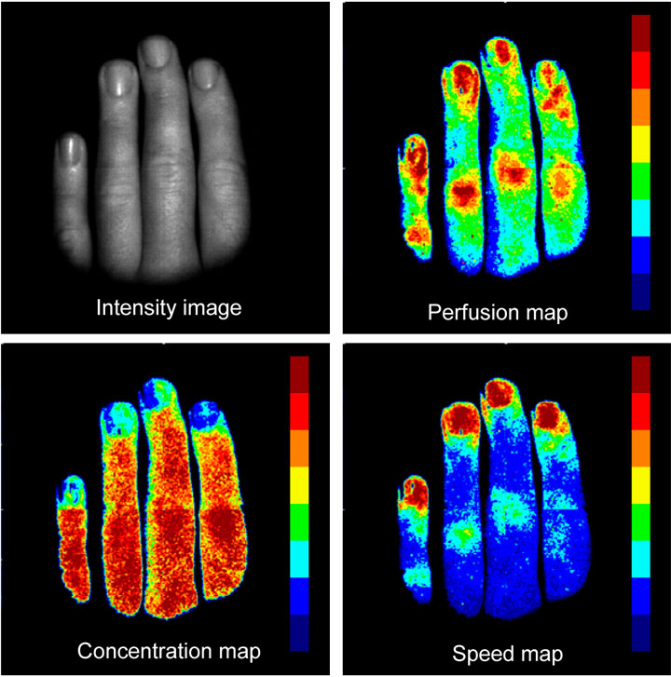
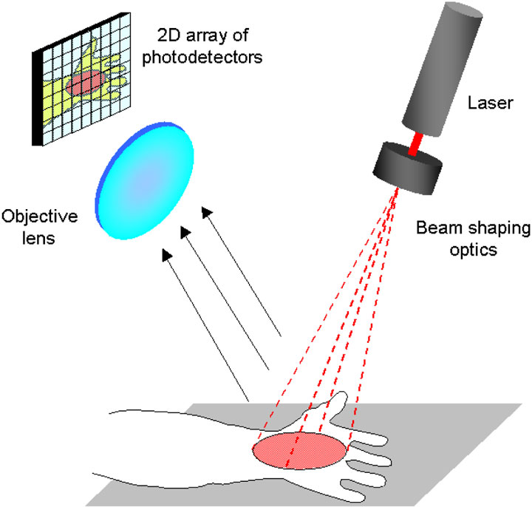
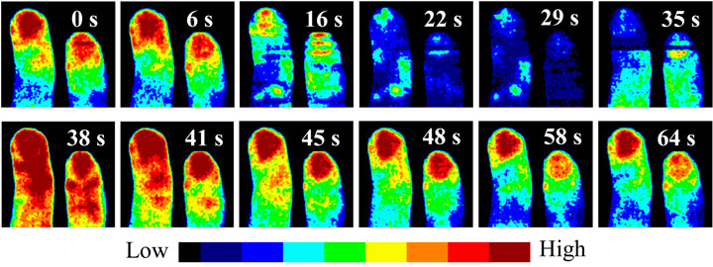
High-speed laser Doppler blood flow imaging
Blood flow-related images of human fingers. Images size is 512 × 512 pixels. The imaging time is 5 seconds in total.
Schematic drawing of a high-speed laser Doppler blood flow imager.
A series of perfusion images (256 × 256 pixels) obtained during the arm artery occlusion experiment. The imaging time is 3 seconds per image. Numbers show the relative time when the image was obtained.
http://spie.org/newsroom/0031-blood-flow-imaging-is-enhanced-using-new-detector-technology
Notes:
Blood flow imaging is enhanced using new detector technology
Alexandre Serov and Theo Lasser
Laser Doppler imaging (LDI), used for measuring in-vivo blood flow in biological tissues such as skin or brain tissue, has dramatically improved by exploiting high-speed CMOS image sensor technology.
7 February 2006, SPIE Newsroom. DOI: 10.1117/2.1200601.0031
Changes in peripheral blood flow are known to be a precise indicator of health disorders. If the blood flow could be measured quickly, reliably, and non-invasively, physicians would be provided with new options for patient screening, earlier disease diagnostic, and monitoring the effect of treatment. Laser imaging is a natural candidate for this as it allows measuring blood flow changes non-invasively and without any physical contact. However, present blood flow imaging systems are not yet suitable for clinical applications, because they are either too slow or insufficiently accurate and require special skills to operate.
There have been several approaches to the development of laser blood flow imagers. Scanning imagers—for instance two different laser Doppler imaging (LDI) systems have been developed by Wårdell et al.¹ and by Essex and Byrne²—suffer from low imagingspeed. Full-field imagers—the laser speckle imagers (LSI) by Fercherand Briers³ and Dunn,⁴ for example—do not distinguish between changes in blood concentration or velocity and cover only a small velocity range. To overcome these problems, we have developed a new imaging system that attempts to incorporate the advantages of both LDI and LSI without featuring the disadvantages.
Our new digital imaging modality uses the latest CMOS image sensor technology. The new imager is based on an integrating CMOS image sensor with random region-of-interest (ROI) addressing capability.⁵ This feature allows the acquisition of the Doppler signal at many spots simultaneously at a sub-frame rate of several kHz. Such a parallel detection approach substantially reduces the measurement time. Integrating detectors also have a better signal-to-noise ratio than non-integrating detectors, especially when measuring simultaneously in a plurality of points. The random addressing integrating detector also allows the use of the same detector for both LDI and LSI, extending the ability of the instrument.
The new laser Doppler imaging system allows imaging and real-time monitoring of blood flow in biological tissues, e.g. skin microcirculation, in an area of up to 15 × 15 cm².The system generates two-dimensional blood flow related maps (perfusion, concentration, and speed) with a frame rate of 0.1Hz to 10Hz, depending on the map size and sampling resolution for fast Fourier transform (FFT). For instance, the system can handle ten 64 × 64 pixel images per second or one 256 × 256 pixel image. In comparison, current commercial systems need more than five minutes for comparable flow-map image quality. The schematic drawing of the full-field laser Doppler imager is illustrated in Figure. 1. An extended laser beam illuminates the sample. The sampleis imaged with an objective lens onto the CMOS image sensor (2D photodetector array). The intensity variations at each pixel are recorded into the computer memory and processed in real time, applying FFT and image speckle contrast analysis algorithms. Here, FFT calculates the Doppler spectrum related to the power spectrum of the intensity fluctuations at the measured point. Perfusion, concentration and speed signals are calculated from the obtained data. Finally, two-dimensional false-color maps of the blood flow are displayed on the computer monitor, as shown in Figure 2 The changes of the blood flow over extended areas of tissue can now be monitored in real time, providing the physician with functiona information about the microcirculation (see Figure 3). In contrast with conventional laser Doppler flowmetry—which measures a single point—functional mapping images not only correlate in magnitude with the degree of perfusion, but also localize changes of blood flow with high spatial specificity.
Figure 1. Schematic drawing of a high-speed laser Doppler blood flow imager.
Figure 2. Blood flow-related images of human fingers. Images size is 512 × 512 pixels. The imaging time is 5 seconds in total.
Figure 3. A series of perfusion images (256 × 256 pixels) obtained during the arm artery occlusion experiment. The imaging time is 3 seconds per image. Numbers show the relative time when the image was obtained.
Our main objective was to develop a reliable, objective, user- and patient-friendly high-speed imaging system for measuring the blood flow in various biological tissues. Although experience is still needed to interpret the images, the measurements themselves could be administered very easily due the instrument design. Our system is a fully user-independent, therefore highly reliable, instrument that greatly reduces costs and improves patient benefit.
Authors
Alexandre Serov and Theo Lasser
Laboratoire d'Optique Biomedicale, École Polytechnique Fédérale de Lausanne
Lausanne, Switzerland

Slide 15
Numerous techniques have been applied to image the cerebral blood flow (CBF) and volume changes
Conventional X-ray angiography (e.g. carotid – сонная артерия) is an excellent clinical tool; however, it is invasive and not suitable for small animal studies; in general, autoradiographic methods provide endpoint 3D spatial information, they contain no information about the dynamic CBF evolution.
Methods based on magnetic resonance imaging and positron emission tomography provide spatial maps of CBF but are limited in their temporal and spatial resolution.
Laser-Doppler flowmetry technique has the desired high spatial resolution, but are limited to two-dimensional mapping of CBF and require surgical opening or substantial thinning of thecranium during the study.
Confocal microscopy, a widely used technique that is capable of ultrahigh resolution mapping of the cerebrovasculature, also requires the removal of intervening bone due to its limited imaging depth (up to 300 μm) and the use of injected fluorescent tissue markers.
Notes:
Numerous techniques have been applied to image the cerebral blood flow (CBF) and
volume changes. Conventional X-ray carotid angiography is an excellent clinical tool;
however, it is invasive and not suitable for small animal studies. Although autoradiographic
methods provide endpoint 3D spatial information, they contain no information about the
dynamic CBF evolution [6]. Methods based on magnetic resonance imaging [7] and positron
emission tomography [8] provide spatial maps of CBF but are limited in their temporal and
spatial resolution. Optical intrinsic signal imaging [9], laser speckle imaging [10] and laser-
Doppler flowmetry techniques [11] have the desired high spatial resolution, but are limited to
two-dimensional mapping of CBF and require surgical opening or substantial thinning of the
cranium during the study. Photoacoustic imaging, based on thermal-acoustic phenomena
resulting from the strong light absorption of blood and the subsequent thermo-elastic
expansion, has recently been reported to map vascular structures deep within the brain of
small animals [12,13]. However, the spatial (~100 μm) resolution of this approach is limited
by the viscoelastic filtering of higher acoustic frequencies by the tissue. Moreover, blood flow
information is not forthcoming with this method. Confocal microscopy, a widely used
technique that is capable of ultrahigh resolution mapping of the cerebrovasculature [14], also
requires the removal of intervening bone due to its limited imaging depth (up to 300 μm) and
the use of injected fluorescent tissue markers.

Slide 16

Blood flow in rat brain capillaries.
In vivo two-photon laser scanning microscopy.
Quantifying blood flow at the level of individual blood vessels
http://www.youtube.com/watch?v=YV1TpkNB0S4
Notes:
This movie shows the movement of red blood cells in capillaries of the rat cortex. It was taken using a technique called in vivo two-photon laser scanning microscopy. The blood serum was labeled with a fluorescent dye (blood cells are not labeled and appear as shadows), while the astrocytes, that form the blood brain barrier, were labeled with sulforhodamine 101. Our laboratory applied methods of quantifying blood flow at the level of individual blood vessels, in order to study functional regulation of blood flow in brain. More info at: http://www-physics.ucsd.edu/neurophysics/

Slide 17
Optical micro-angiography (OMAG)
(OMAG) is a recently developed imaging method, capable of resolving 3D distribution of dynamic blood perfusion at the capillary level within microcirculatory beds in vivo. The imaging contrast of blood perfusion is based on the endogenous light scattering from the moving blood cells within biological tissue; thus no exogenous contrasting agents are necessary. This is achieved by efficient separation of the moving scattering elements from the static scattering ones within tissue through the OMAG hardware associated with mathematical analysis of the optical scattering signals from an illuminated sample.
Its development has its origin in the Fourier domain optical coherence tomography (FDOCT) [16]. OMAG improves over previous methods, e.g. FDOCT and Doppler OCT [17-20] by introducing a constant frequency modulation fM into the time varying spectral interferograms at the time when the probing beam is scanned over the sample. The introduction of fM in the interferograms was achieved by linear translation of the reference mirror in the interferometer, synchronized with the OCT cross-sectional (B scan) imaging. This makes it possible to separate the light scattering signals backscattered from the moving particles, such as moving blood cells, from those backscattered from the static particles, such as bulk tissue, leading to high resolution mapping of dynamic blood perfusion down to capillary levels within thick tissue sample in vivo. In essence, the OMAG method maps the scattering signals from the moving particles into one image, i.e. flow image, and from the static particles into a second image, i.e. microstructural image. The previous reported OMAG system used light source centered at ~840nm that has shown capable of imaging cerebro-vascular blood perfusion in mice with the cranium intact [15]. It would be desirable that the cerebro-vascular blood perfusion can be accessed without removal of the overlaying skin so that the possible complications of dynamic blood flow due to surgical interventionscan be minimized.
Notes:
Optical micro-angiography (OMAG) [15] is a recently developed imaging method,
capable of resolving 3D distribution of dynamic blood perfusion at the capillary level within
microcirculatory beds in vivo. The imaging contrast of blood perfusion is based on the
endogenous light scattering from the moving blood cells within biological tissue; thus no
exogenous contrasting agents are necessary. This is achieved by efficient separation of the
moving scattering elements from the static scattering ones within tissue through the OMAG
hardware associated with mathematical analysis of the optical scattering signals from an
illuminated sample. Its development has its origin in the Fourier domain optical coherence
tomography (FDOCT) [16]. OMAG improves over previous methods, e.g. FDOCT and
Doppler OCT [17-20] by introducing a constant frequency modulation fM into the timevarying
spectral interferograms at the time when the probing beam is scanned over the
sample. The introduction of fM in the interferograms was achieved by linear translation of the
reference mirror in the interferometer, synchronized with the OCT cross-sectional (B scan)
imaging. This makes it possible to separate the light scattering signals backscattered from the
moving particles, such as moving blood cells, from those backscattered from the static
particles, such as bulk tissue, leading to high resolution mapping of dynamic blood perfusion
down to capillary levels within thick tissue sample in vivo. In essence, the OMAG method
maps the scattering signals from the moving particles into one image, i.e. flow image, and
from the static particles into a second image, i.e. microstructural image. The previous reported
OMAG system used light source centered at ~840nm that has shown capable of imaging
cerebro-vascular blood perfusion in mice with the cranium intact [15]. It would be desirable
that the cerebro-vascular blood perfusion can be accessed without removal of the overlaying
skin so that the possible complications of dynamic blood flow due to surgical interventions
can be minimized

Slide 18
The head of an adult mouse with the skin and skull intact was imaged with Optical Micro-Angiography (OMAG) in vivo
2007 / Vol. 15, No. 18 / OPTICS EXPRESS 11402
Notes:
Fig. 6. The head of an adult mouse with the skin and skull intact was imaged with OMAG in
vivo. (A) and (B) are the projection views of blood perfusion from within the skin and the brain
cortex, respectively. Capillary blood flow can be seen from (B). It took ~7.5 minutes to acquire
the 3-D data to obtain (A) and (B) using the current system setup. (C) Photograph taken right
after the experiments where viewing the vasculatures through the skin is impossible. (D)
Photograph showing blood vessels over the cortex after the skull and the skin of the same
mouse were carefully removed. The superficial major blood vessels show excellent
correspondence with those in (B). The area marked with dashed white box represents 4.2 by 7.2
mm2; and the scale bar indicates 1.0 mm.

Slide 19
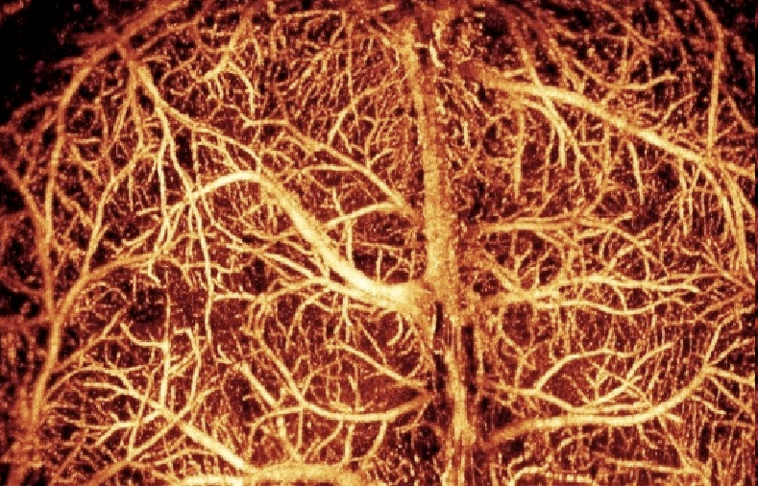
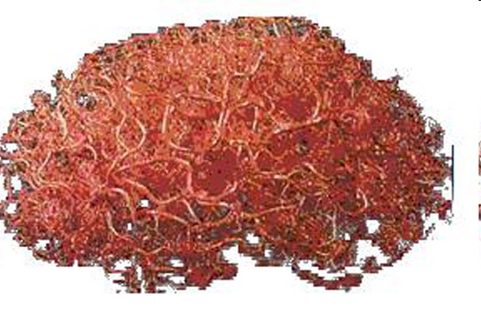
Optical micro-angiography of Mouse and Human Brain
http://www.jyi.org/research/re.php?id=1607
In vivo imaging of blood flow in microcirculation of brain tissue (mouse)
In vivo image of blood vessels in mouse brain. OMAG can quantify blood flow of the microcirculation within a 3D image.
Current studies are investigating the changes in the blood perfusion of superficial brain layers during and after stroke in a mouse model. Image of blood vessels through intact skull, contrast based on blood flow. Image is mosaic of six OMAG images to cover 4mm x 6mm field of view.
www.bme.ogi.edu/biomedicaloptics/biophotonics/projects.html#OMAG
Notes:
Optical micro-angiography (OMAG) [15] is a recently developed imaging method,
capable of resolving 3D distribution of dynamic blood perfusion at the capillary level within
microcirculatory beds in vivo. The imaging contrast of blood perfusion is based on the
endogenous light scattering from the moving blood cells within biological tissue; thus no
exogenous contrasting agents are necessary. This is achieved by efficient separation of the
moving scattering elements from the static scattering ones within tissue through the OMAG
hardware associated with mathematical analysis of the optical scattering signals from an
illuminated sample. Its development has its origin in the Fourier domain optical coherence
tomography (FDOCT) [16]. OMAG improves over previous methods, e.g. FDOCT and
Doppler OCT [17-20] by introducing a constant frequency modulation fM into the timevarying
spectral interferograms at the time when the probing beam is scanned over the
sample. The introduction of fM in the interferograms was achieved by linear translation of the
reference mirror in the interferometer, synchronized with the OCT cross-sectional (B scan)
imaging. This makes it possible to separate the light scattering signals backscattered from the
moving particles, such as moving blood cells, from those backscattered from the static
particles, such as bulk tissue, leading to high resolution mapping of dynamic blood perfusion
down to capillary levels within thick tissue sample in vivo. In essence, the OMAG method
maps the scattering signals from the moving particles into one image, i.e. flow image, and
from the static particles into a second image, i.e. microstructural image. The previous reported
OMAG system used light source centered at ~840nm that has shown capable of imaging
cerebro-vascular blood perfusion in mice with the cranium intact [15]. It would be desirable
that the cerebro-vascular blood perfusion can be accessed without removal of the overlaying
skin so that the possible complications of dynamic blood flow due to surgical interventions
can be minimized.

